Slide 1
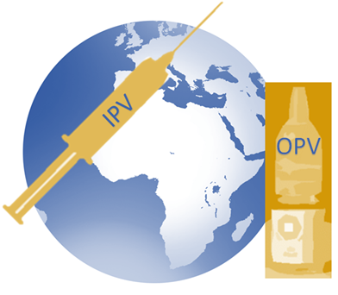
IPV Introduction and OPV Withdrawal
Rationale and Programmatic Implications for Objective 2 of The Polio Eradication and Endgame Strategic Plan
Immunization Systems Management Group (IMG)
25 March 2014
Notes:
1
© 2012 IMG

Slide 2
Glossary of terms & abbreviations
cVDPV Circulating Vaccine-Derived Poliovirus
DTP3 Diphtheria Tetanus Pertussis (third dose)
GPEI Global Polio Eradication Initiative
IMG Immunization Systems Management Group
IPV Inactivated Polio Vaccine
OPV Oral polio vaccine
  tOPV (trivalent, contains types 1, 2 and 3)
  bOPV (bivalent, contains types 1 and 3)
  mOPV 1, 2 or 3 (monovalent, types 1, 2 or 3)
  OPV2 Type 2 oral polio vaccine
SAGE Strategic Advisory Group of Experts on Immunization
VAPP Vaccine-associated paralytic poliomyelitis
VDPV Vaccine-derived poliovirus
WHA World Health Assembly
WHO World Health Organization
WPV Wild poliovirus

Slide 3
Objectives
Provide background on Polio & Polio vaccines as it relates to Objective 2 of GPEI’s Polio Eradication & Endgame Strategic Plan
    SAGE recommendations
Programmatic implications of IPV introduction
  Partner coordination & technical assistance
  IPV Vaccine Presentation
  Country readiness
  Supply & Price
  Communications
GAVI Policies and Processes

Slide 4
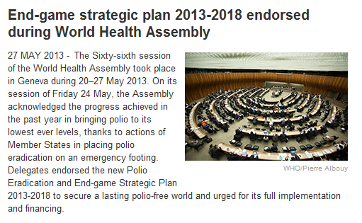
Background
Poliovirus eradication is a programmatic emergency for global public health by World Health Assembly (2012).
In response, the Polio Eradication and Endgame Strategic Plan 2013-2018 was developed and endorsed by WHA (2013)

Slide 5
GPEI Accomplishment: Significant decline in number of persons paralyzed by wild polioviruses, 1988-2013*
*as of 31 December 2013

Slide 6
As wild polioviruses are eradicated, number of circulating vaccine-derived cases exceeds wild poliovirus cases
A hypothetical scenario of estimated VDPV cases compared to reported cases of wild poliovirus (as of 31 December, 2013)

Slide 7
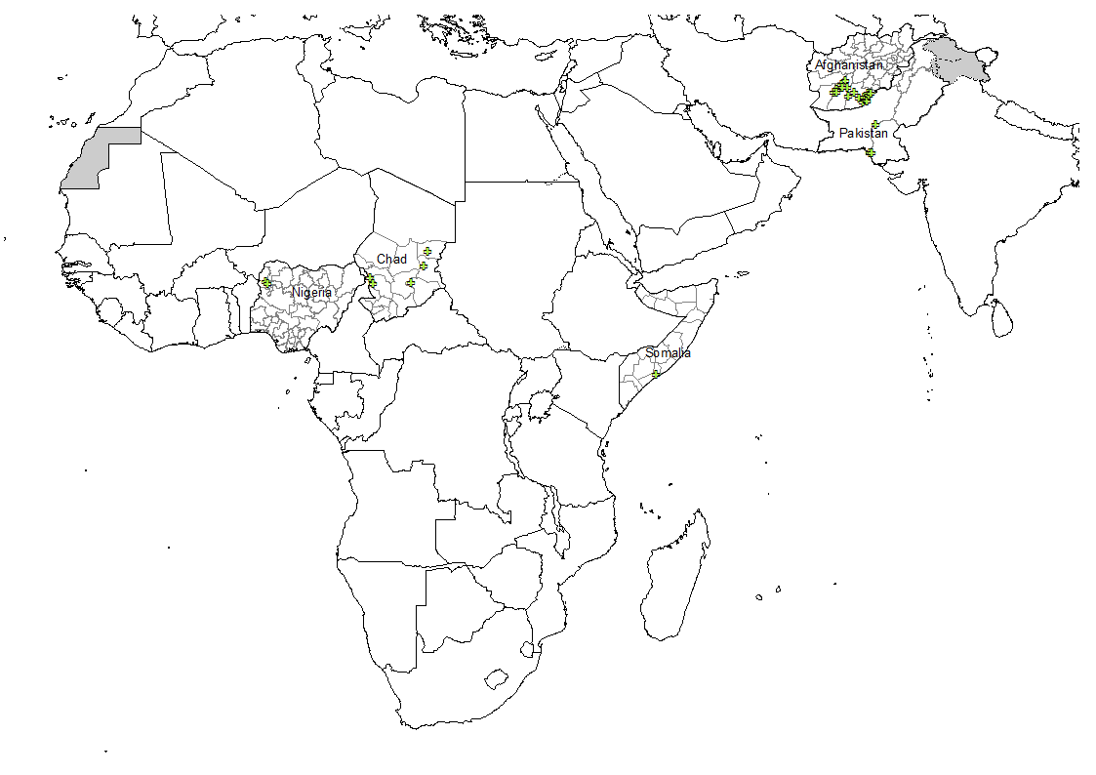
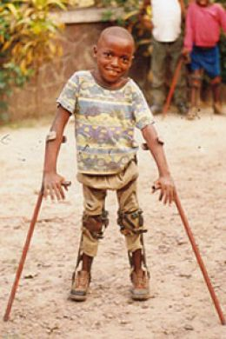
Vaccine virus outbreaks, last 6 months
All recent cVDPV outbreaks are due to Type 2 virus

Slide 8
Last type 2 wild poliovirus: 1999
however…..

Slide 9
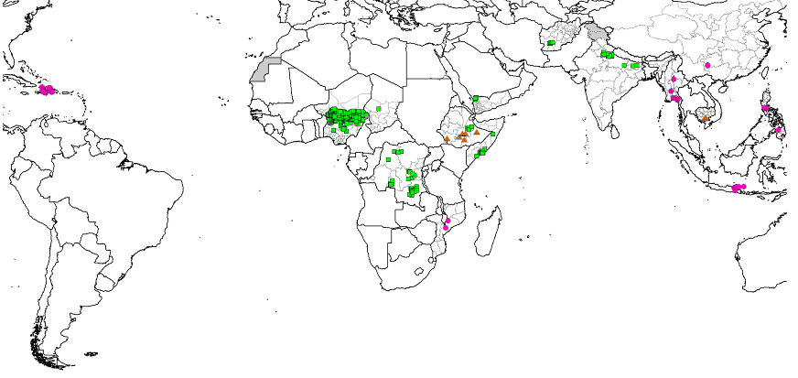
circulating Vaccine-Derived Poliovirus
Outbreaks (cVDPVs), 2000-2011
>90% of cVDPV polio cases are due to type 2
Type 1 (79 cases)
Type 2 (478 cases)
Type 3 (9 cases)

Slide 10
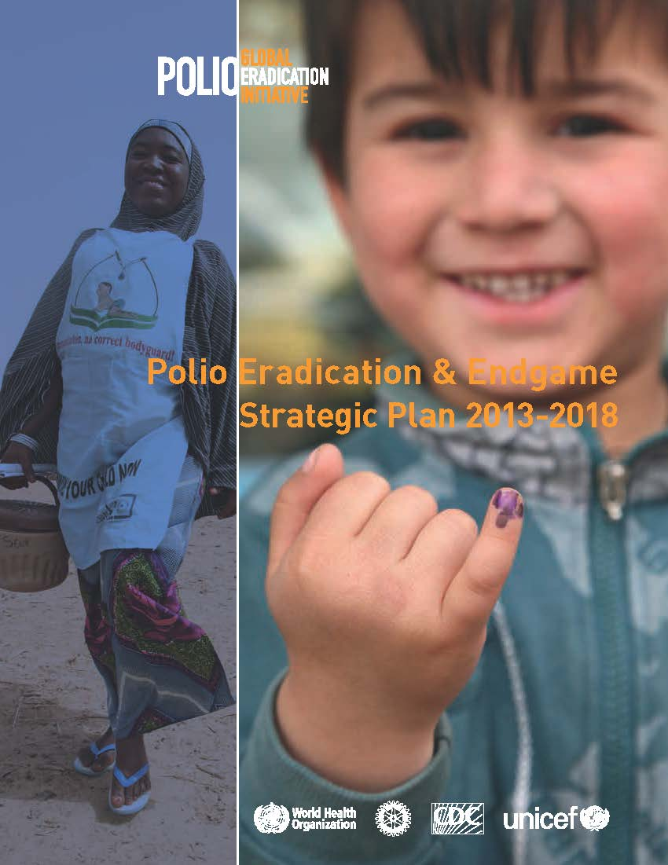
The Polio Eradication & Endgame Strategic Plan 2013-2018
The Plan differs from previous eradication plans because it addresses paralytic cases associated with both wild polioviruses and vaccine-derived poliovirus/VAPP
Eradication
  refers to wild virus
Endgame
  refers to management of VDPVs and VAPP

Slide 11
Goal: to complete the eradication & containment of all wild, vaccine-related and Sabin polioviruses.

Slide 12
The Plan has Four Objectives
1
Detect and interrupt all poliovirus transmission
2
Strengthen immunization systems, introduce inactivated polio vaccine (IPV) and withdraw oral polio vaccines (OPV)
3
Contain poliovirus and certify interruption of transmission
4
Plan polio’s legacy

Slide 13
Endgame Major
Objectives
Last wild polio case
Last OPV2 use
Certification
2013 2014 2015 2016 2017 2018
Virus detection & interruption
Wild virus
interruption
Outbreak response
(esp. cVDPVs)
RI strengthening & OPV withdrawal
RI strengthening
OPV2 pre-requisites
Introduce IPV
OPV2
withdrawal
Containment & certification
Finalize long-term containment plans
Complete containment
& certification globally
Consultation & strategic plan
Initiate implementation of legacy plan
Legacy Planning

Slide 14
Objective 2 of The Plan addresses the Endgame through three distinct stages
Introduction
Switch
Withdrawal
at least one dose of IPV
tOPV to bOPV
of bOPV & routine OPV use
into routine immunization
2019-2020
2016
Before end
2015
Ongoing STRENGTHENING of routine immunization services

Slide 15
Polio strengthening routine immunisation
Implement and monitor the use of polio assets for routine immunisation strengthening
  Human (e.g. polio staff supported by GPEI in WHO and UNICEF)
  Physical (e.g. vehicles)
  Systems/Networks (e.g. surveillance and monitoring data)
  Experience (e.g. microplanning)
Concentrate on the country level
  Assets are concentrated in key countries with priority for broader immunisation agenda
Use existing cMYPs / annual plans to guide interventions
  Support should be implemented based on national context and priorities
Develop flexible 'packages' of potential support interventions

Slide 16
Endgame targets for routine immunization strengthening
Develop annual national immunization coverage improvement plans in 10 focus countries by end 2014.
Dedicate >50% of polio-funded field personnel’s time in the focus countries to immunization systems strengthening tasks.
Achieve 10% (relative) year-on-year improvement in DTP3 coverage rates in high-risk districts in 10 focus countries beginning in 2014.

Slide 17
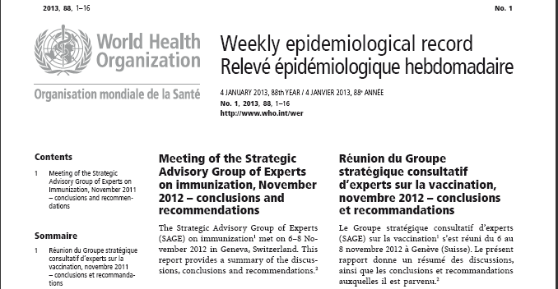
SAGE 11/2012: Recommend at least 1 dose of IPV into routine schedules (risk mitigation)

Slide 18
Rationale for introducing at least one dose of IPV prior to the tOPV-bOPV switch
IPV protects children against poliovirus types 1, 2 and 3. Introducing IPV prior to the tOPV-bOPV switch will maximize the proportion of the population protected against type 2 polio after OPV2 cessation. One dose of IPV will:
Reduce risks
Hasten eradication
Interrupt transmission if outbreaks occur
Reduce risks associated with type 2 cessation
  Lower risk of re-emergence of type 2 polioviruses
Facilitate interruption of transmission with the use of monovalent OPV2 if type 2 outbreaks occur
Boost immunity against types 1 & 3 thus hastening polio eradication
IPV
Notes:
At least 1 dose of IPV used globally would improve population immunity
Reduces the consequences of type 2 re-emergence by inducing population immunity
Seroconversion* is generally 32-65% for the first dose of IPV
Virtually all who do not seroconvert are still immunologically primed**
and may be protected against clinical polio
In the event of a type 2 polio outbreak as a result of reintroduction of the type 2 viruses
a significant proportion of children who have received IPV would already be immune
a dose of mOPV2 in an SIA for outbreak response would lead to higher immunity levels in a population that has received 1 dose of IPV previously than use of mOPV2 in a naïve population because these children will have received 2 doses of a polio containing vaccine instead of just the 1 dose administered in an SIA
IPV boosts systemic immunity (protects against paralytic disease) and intestinal immunity (reduces transmission) in OPV primed populations to all vaccine types contained in prior OPV doses - i.e. it will boost immunity to types 1 and 3, hastening interruption of transmission and providing insurance against reintroduction from other populations.

Slide 19
Planned use of IPV: SAGE Recommendations
SAGE recommended that all countries introduce at least 1 dose of IPV in their routine immunization programmes to mitigate the risks associated with the withdrawal of type 2 component of OPV
  Single dose of IPV at 14 weeks of age with DTP3, in addition to OPV3 or OPV4.
  Countries have flexibility to consider alternative schedules
  All endemic and other high risk countries should develop a plan for IPV introduction by mid-2014 and all OPV-only using countries by end-2014
Summary of SAGE Meeting at http://www.who.int/immunization/sage/report_summary_november_2013/en/index.html

Slide 20
Rationale for administering IPV after 14 weeks of age, in the context of the Endgame Plan
The immune response to intramuscularly administered IPV varies based on the number of administered doses (higher with more doses) and the age at vaccination (higher with delayed immunization).
  3 doses: ~100% against all 3 serotypes
  2 doses: ~90% against all 3 serotypes, when administered >8 weeks of age
  1 dose: ~19%-46% against Type 1, 32%-63% against Type 2,
  and 28%-54% against Type 3 poliovirus.
The immune response to one dose of IPV is substantially higher against Type 2 poliovirus (63%) when administered at 4 months of age compared to 6 weeks to 2 months of age (32%-39%).
Thus, SAGE recommends a single dose of IPV at 14 weeks or first contact afterwards, or with DTP3/OPV3/OPV4, in the EPI schedule

Slide 21
Rationale for SWITCH from tOPV to bOPV in 2016
Risks of OPV2 far outweigh the benefits
Type 2 wild poliovirus apparently eradicated since 1999 (last case detected in Aligarh, India)
New diagnostics and experience suggest that type 2 polio vaccine causes >95% of VDPVs
Type 2 causes approximately 40% of VAPP today
Type 2 component of OPV interferes with immune response to types 1 and types 3

Slide 22
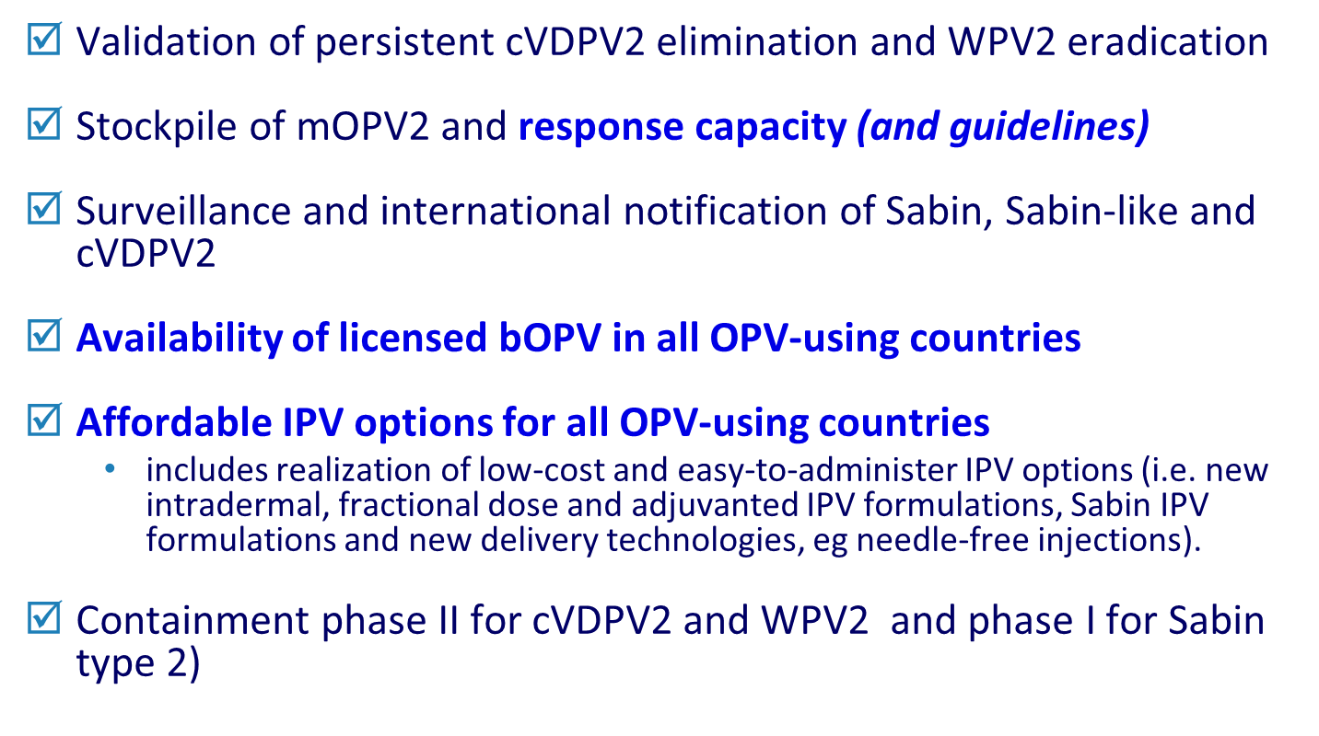
Pre-requisites for tOPV-bOPV switch

Slide 23
Key messages for IPV introduction & OPV withdrawal
IPV recommended by SAGE
  All countries introduce at least one dose of IPV into the routine immunization system before the tOPV-bOPV switch
OPV withdrawal crucial
  OPV withdrawal must occur for the world to be polio free because OPV in rare cases can cause paralytic disease
OPV withdrawal—
Two phases
  Removal of type 2 in 2016 (tOPV to bOPV switch globally)
  bOPV cessation in 2018-2019 (complete OPV withdrawal)
IPV rationale
  Ensures that a substantial proportion of the population is protected against type 2 polio after OPV2 cessation
Added IPV benefits
  Mitigates risks of type 2 reintroduction in association with OPV2 cessation and facilitates polio eradication by boosting immunity to types 1&3
IPV clarifications
  Recommended for routine immunization - not campaigns
  Recommended in addition to OPV - not replacing any OPV doses

Slide 24
Programmatic Implications of IPV Introduction

Slide 25
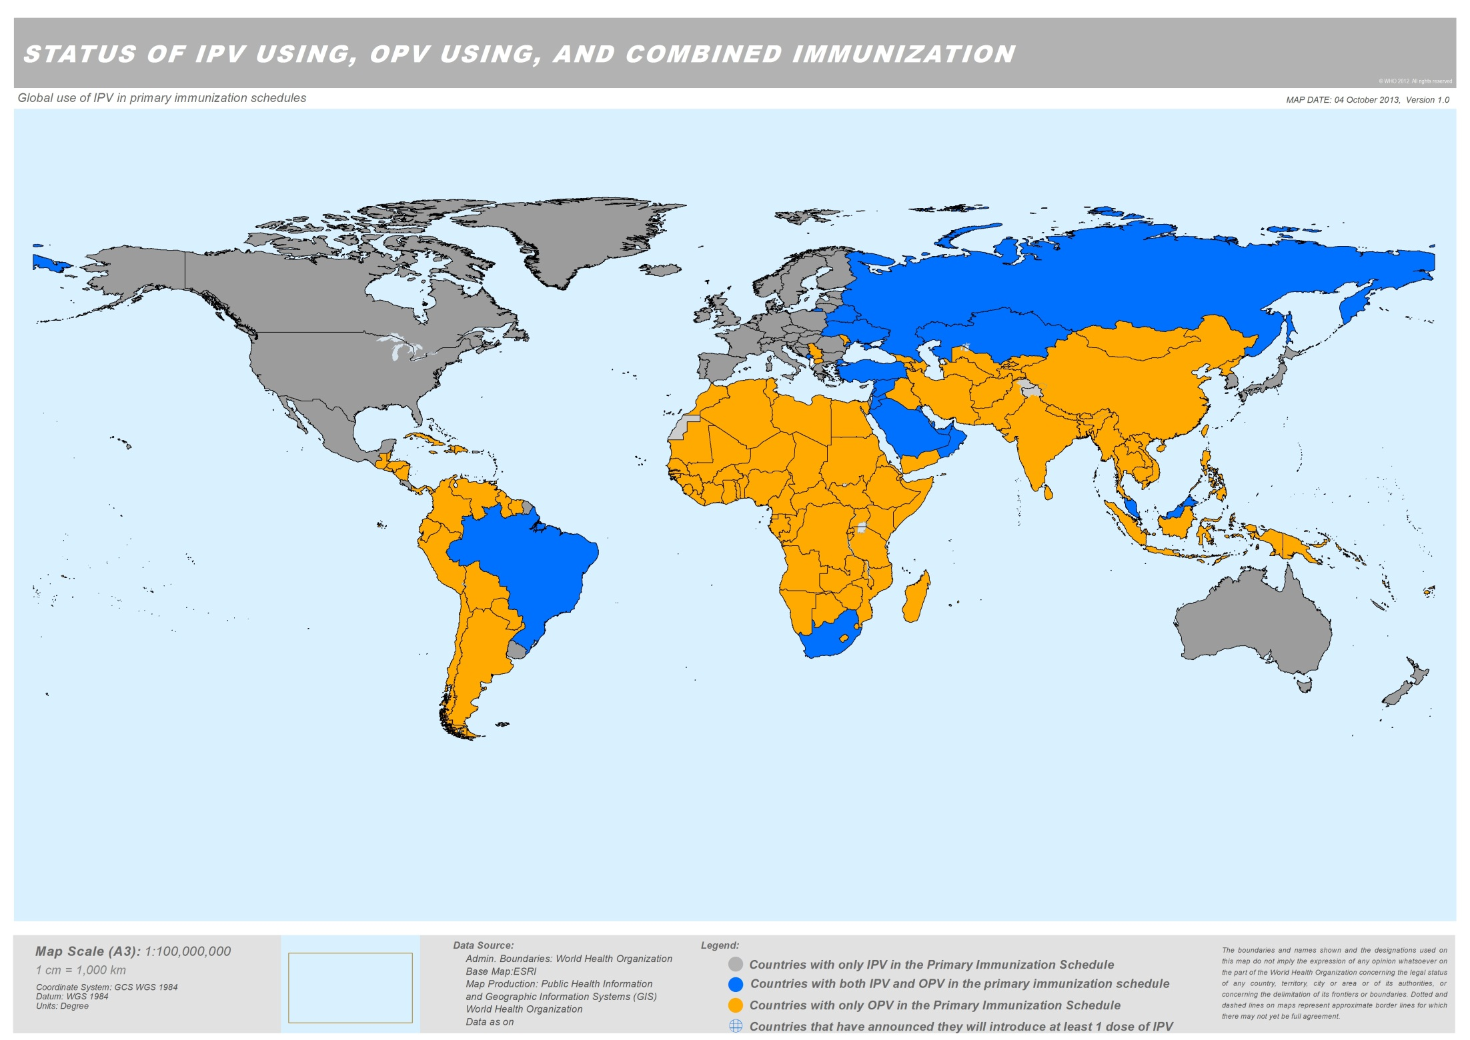
OPV only (Announced future IPV introduction) | 124 (1)
IPV only using | 50
Sequential (IPV + OPV) | 20

Slide 26

Introducing in 124 countries warrants coordinated multi-partner effort
Oversight group jointly chaired by WHO and UNICEF
Membership from core GPEI partners & GAVI:
  CDC
  Rotary International
  Bill & Melinda Gates Foundation (BMGF)
  WHO and UNICEF (HQ and regional level)
  GAVI
Notes:
One of the objectives is to introduce at least 1 dose of Inactivated Polio Vaccine (IPV) into routine immunization schedules and withdraw Oral Polio Vaccine (OPV) in a phased manner, starting with type 2-containing OPV.

Slide 27
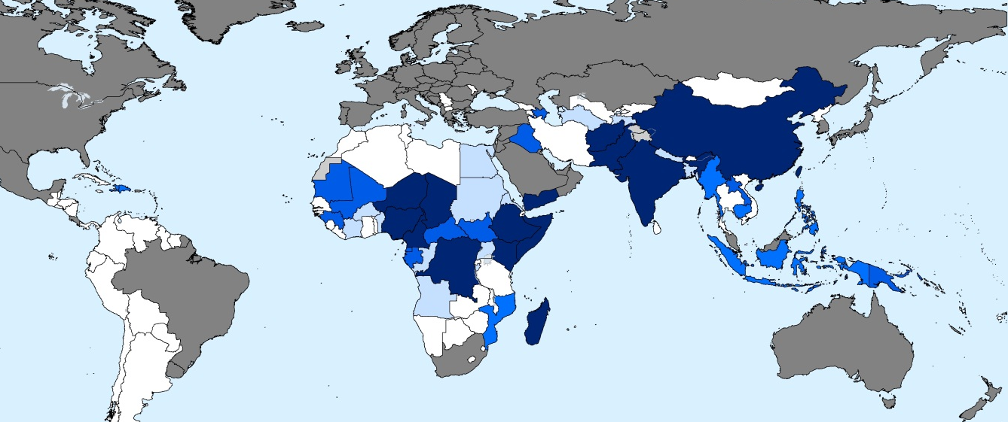
Tiers of OPV-using countries & birth cohort
% of birth cohort
24%
38%
61%
72%
83%
100%
India
China
Tier 1
Tier 2
Tier 3
Tier 4
# of countries
12
countries
19
countries
14
countries
77
countries

Slide 28
Criteria for tiering countries
Tier 1- Highest risk
  Countries with evidence of ongoing cVDPV2 transmission or cVDPV2 reported since 2000
    cVDPV2 outbreak is the primary risk following OPV type 2 cessation
  WPV endemic countries
    Potential for IPV to accelerate wild poliovirus eradication by boosting immunity to WPV types 1 and 3
Tier 2- Second highest risk
  Countries with any history of cVDPVs (types 1 and 3) since 2000
    Risk factors for VDPV outbreaks are similar for all VDPV serotypes
  Countries that have repeatedly reported routine immunization coverage estimates of < 80% over the past three years
    Persistent low routine immunization coverage is the most important predictor of VDPV emergence

Slide 29
Criteria for tiering countries
Tier 3:
  Countries sharing a border with Tier 1 countries that have reported WPV since 2003
    Predicted future risk of cVDPV2 importations, based on trends for importation of wild virus
  Countries that have experienced a WPV importation since 2011.
    Any WPV importation since 2011 (when India eradicated polio) reflects current risk of importation from remaining endemic countries.
Tier 4:
  All other remaining countries using only OPV

Slide 30
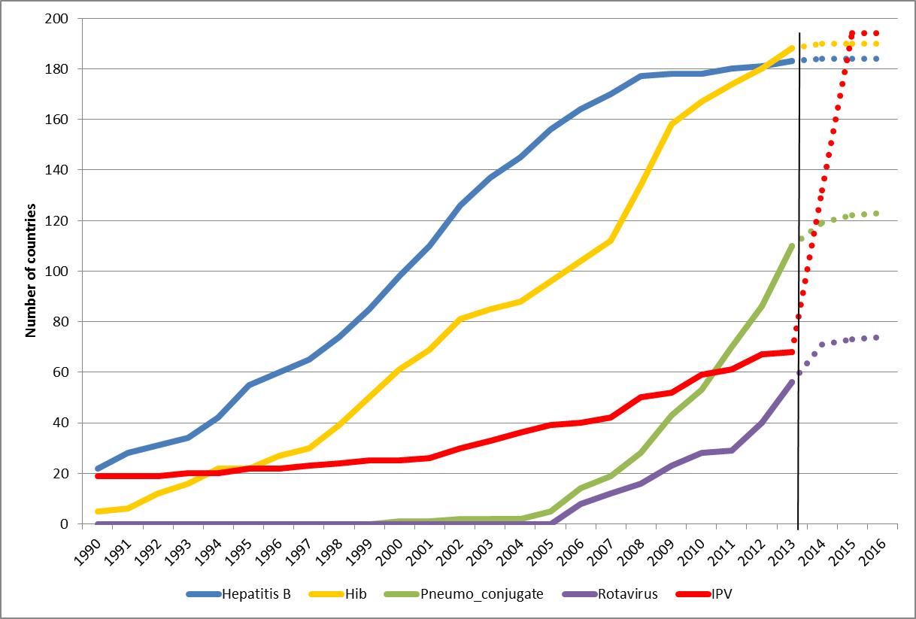
Immunization schedule uptake
Overview 1991-2013 of introduction status and 2014-2016 projections
Source: WHO/IVB Database as at 18 October 2013

Slide 31
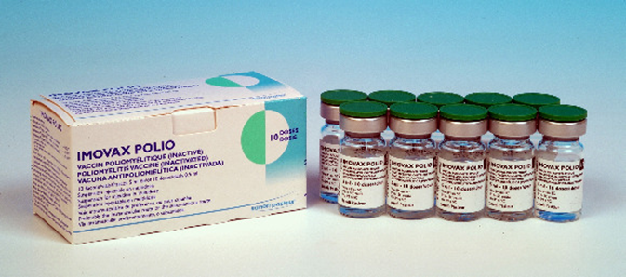
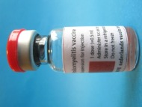
IPV Presentations and Formulations
Stand-alone IPV
  Only WHO prequalified formulation
  1-dose, [2-dose] and 10-dose available now
  5-dose expected in 2014
  Preservative: 2-phenoxyethanol does not meet WHO requirements for an effective preservative (multi-dose vial, once opened, must be discarded after 6 hours or at end of immunization session)
Combination products
  Combination with whole-cell pertussis not currently available
  Tetravalent, pentavalent, hexavalent available
  Substantially higher cost than stand-alone IPV

Slide 32
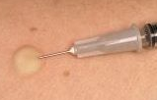
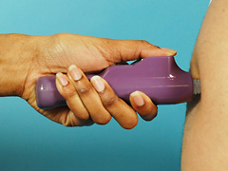
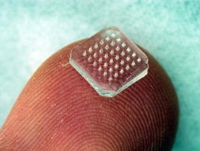
Intradermal IPV: Potential solutions
Adapters (e.g., Nanopass)
Compatible with needle & syringe administration
Some devices (MicronJet, ID adapter, and BD Soluvia) already registered for ID use
Still requires needle and syringe
Trained health care
workers required
Jet Injectors (e.g., Pharmajet, Bioject)
Clinical data available in different settings
A pathway for national registration and PQ is relatively clear
No needles but some training required
Microneedle patch
Easiest to administer; little training needed
No IPV data available in humans
Need to establish a large scale production process and regulatory pathway
Trained health care
workers NOT required

Slide 33
Considerations for Planning and Logistics
Coordination with other introductions
  Many countries have planned introductions for other new vaccines (e.g., rotavirus, PCV) so need coordinated effort
Multi Dose Vial Policy (MDVP)
  IPV can only be kept for 6 hours or until the end of the vaccination session once the vial is opened
High Wastage Rates
  50% for 10-dose vial and 30% for 5-dose vial
Licensing
  IPV must be licensed in country or country must accept WHO prequalified product
Cold chain
  Limited impact on cold chain due to addition of IPV, but may be challenging in context of other introductions

Slide 34
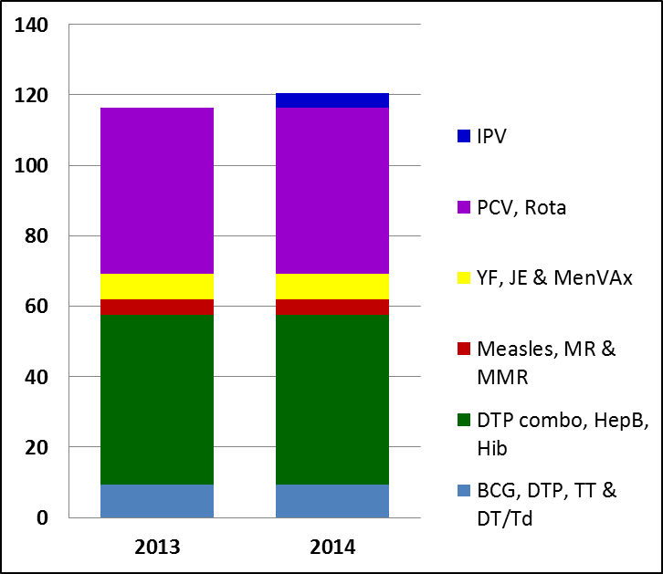
IPV Impact on cold chain is limited
Figure shows that estimated impact of one dose of IPV is limited on cold chain in DRC
Countries’ systems already stressed, and introduction of IPV and other new vaccines is an opportunity to address issues and constraints
DRC
Vaccine Volumes per FIC (cm3)

Slide 35
Pilot introductions, training materials, and deployable consultants
Discussions with all WHO & UNICEF regional offices to engage countries
  Planning for possible “Pilot Countries" (early 2014)
  Objective would be early identification of operational issues associated with IPV introduction and its impact on the existing immunization system in the countries, so that they can be corrected and shared with other countries
Ensuring in-country registration of stand-alone IPV or that WHO prequalification is accepted
Development of NITAG & training materials underway
Planning training of cadre of deployable training consultants that would be available to provide technical assistance to countries
Case studies ongoing to share experience from countries with “dual” new vaccine introductions and issues related to multiple injections

Slide 36
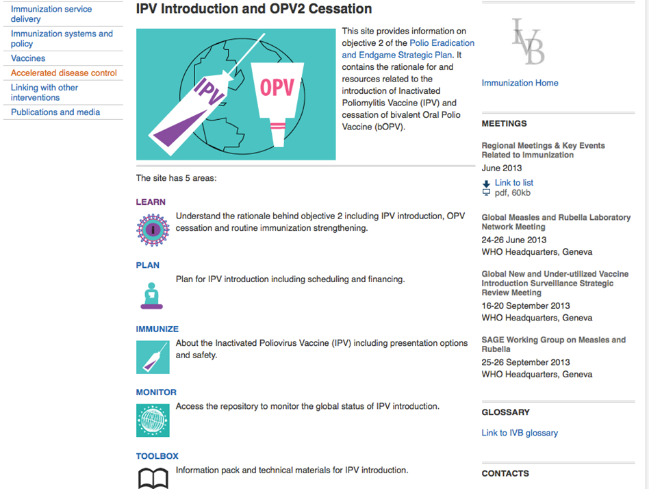
IPV webpages live: http://www.who.int/immunization_delivery/adc/inactivated_polio_vaccine/en/

Slide 37
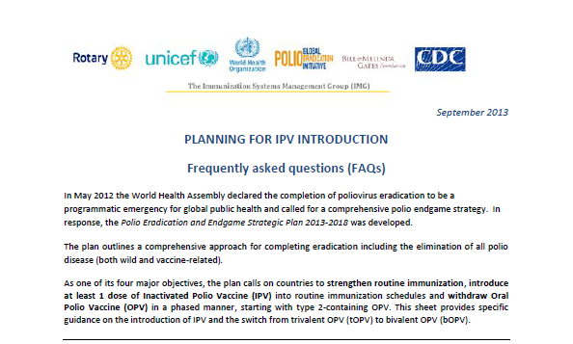
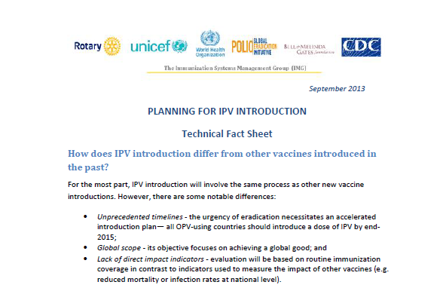
Communications & Advocacy: Fact Sheets, FAQs, slides sets, and technical documents available on the IPV website

Slide 38
Vaccine Demand Forecast & Supply
GPEI has ensured sufficient production capacity for current IPV stand-alone products to meet the needs of all OPV using countries to introduce one dose of IPV into their routine immunization programme
  Initial global demand forecast: 580-624 million doses needed by 2018
However, to ensure sufficient IPV is available when countries are ready to introduce, it is essential that all countries define target introduction dates no later than mid-end 2014
Four manufacturers currently produce stand-alone IPV
  Sanofi- Pasteur, France (SP)
  Serum Institute of India (SII)
  GlaxoSmithKline, Belgium (GSK)
  Statens Serum Institut, Denmark (SSI)

Slide 39
Forecasts 2014-2018: 580m- 624m doses
UNICEF Tender: issued 4 October- closing 15 November
Assumptions: 124 Countries, 1 dose at DTP3; 5 and 10 dose vials (30% and 50% wastage) ; DTP3 coverage reached over one year /two years for large countries

Slide 40
IPV Price US$ – Current & Future
GPEI aims at following pricing levels:
  Low-income: ~US$ 1.00 per dose
  Lower-middle income: ~US$1.50 per dose
CURRENT Public Sector Price for IPV ranges from ~$2 to $12
Country | Vaccine | Cost per dose
USA¹ | Sanofi (10 dose vial) | $12.42
PAHO² | GSK (1 dose) | $4.14
 | Bilthoven (1 dose) | $2.90
Current UNICEF tender³ | GSK (1 dose) | $4.14
 | Sanofi (10 dose vial) | $2.25 - $2.70
 | SSI (1 dose) | $5.70
http://www.cdc.gov/vaccines/programs/vfc/awardees/vaccine-management/price-list/index.html
http://www.paho.org/hq/index.php?option=com_content&view=article&id=1864&Itemid=2234&lang=en
http://www.unicef.org/supply/index_66260.html

Slide 41
IPV Prices for Supply through UNICEF for period 2014 - 2018
Prices are published on UNICEF website http://www.unicef.org/supply/index_57476.html

Slide 42
Programmatic questions to OPV switch
Globally Synchronized Switch – cannot work without global consensus!
No country currently has bOPV in its routine programme
  All 145 countries (ie those with tOPV only and tOPV & IPV schedules) have to switch to bOPV
  At least 75 self-procuring, non GAVI-eligible countries have to licence bOPV and establish post-marketing mechanisms
  UNICEF / PAHO RF tendering mechanism
Withdrawal of tOPV
  Anti hoarding mechanisms
  Verification mechanisms?

Slide 43
Policy Aspects Related to IPV
GAVI-GPEI Partnership on Introduction of IPV

Slide 44
GAVI – GPEI Partnership
GPEI and the GAVI Alliance recognise the importance of strong partnership and complementarity; partners are now working together to improve coordination and strengthen routine immunisation services
In November 2013, the GAVI Alliance Board approved to support introduction of IPV in the world’s 73 poorest countries, including adjustments to GAVI policies and processes to facilitate meeting GPEI’s accelerated introduction timelines for IPV.

Slide 45
Letters to countries (WHO DG, UNICEF ED, GAVI CEO)
Joint WHO/UNICEF/GAVI letters to GAVI eligible LICs in Dec 2013
Joint WHO/UNICEF letters to all other countries in Dec 2013
Update on IPV introduction support mechanisms and timelines

Slide 46
GAVI support for IPV
GAVI Alliance Board decisions November 2013
Eligibility
  73 GAVI eligible and graduating countries.
Immunisation coverage filter
  Requirement to have 70% DTP3 coverage before applying for vaccine support does not apply
Duration of support
  Until 2024 (subject to funding beyond 2018)
Application submission window
  Until June 2015 with introduction targeted by end 2015
Co-financing
  All countries exempted even if country is in default; however co-financing still recommended
Introduction grant
  GAVI countries eligible for vaccine introduction grant
  *All policy exceptions to be reviewed in 2018

Slide 47
Application documents for IPV
The GAVI IPV application guidelines include information on the requirements, processes and timelines to support applications submitted by 30 March 2014.
The following documents must be completed and submitted when applying for IPV:
  Annex A. IPV introduction plan
  Annex B. IPV application form
  Annex C. IPV introduction timeline of activities
  Annex D. Budget and financing for IPV introduction
  All of the above materials are available from GAVI web site at: http://www.gavialliance.org/support/apply/
Updated application guidelines will be available for countries submitting after 30 March 2014.

Slide 48
GAVI Secretariat-led application processes
Voluntary Expression of Interest by country
Tailored application
Applications reviewed by Independent Review Committee (IRC)
– Alliance partner input through open sessions
CEO empowered by Board to approve applications after IRC review
Regular GAVI processes for:
  Procurement
  Vaccine introduction grant transfer
  Provision of technical assistance
  Reporting

Slide 49
Application timelines for IPV and all GAVI support in 2014
http://www.gavialliance.org/support/apply/
 | Expression of Interest cut-off dates | Application submission cut-off dates | Independent Review Committee dates | GAVI CEO or Executive Committee decision | Guidelines and forms to be used for applications
For IPV only | N/A | 6 February | 27 February – 7 March | Within four weeks of the IRC | Available now on GAVI web site
 | N/A | 30 March | 28 – 30 April
For all new vaccines, IPV and health systems strengthening | 1 March | 1 May | 23 June – 4 July | September 2014. For IPV only, four weeks after IRC review. | Materials to be published in early 2014.
 | 15 May | 15 September | 10 – 21 November | February 2015. For IPV only, four weeks after IRC review.

Slide 50
GAVI support for IPV: actions for countries
Countries are encouraged to continue discussions on IPV introduction in the routine immunisation programme and on switching OPV
Discussions should take into account:
  The timelines of the Endgame Plan
  Action needed on key technical steps, such as licensure of IPV and bOPV in your country, and cold chain and routine immunisation program improvements
WHO, UNICEF, and the entire GAVI Alliance are committed to supporting efforts to strengthen routine immunisation

Slide 51
Support for non-GAVI OPV countries
WHO and UNICEF committed to help all countries introduce IPV rapidly
All countries are eligible for technical support in planning for and introducing IPV. Requests through local WHO and UNICEF country offices.
Facilitate access to low cost IPV products through UNICEF-procurement processes:
Potential time-limited vaccine funding support, if necessary

Slide 52
Key Dates Relevant to Objective 2, 2014-2020
Date | Timeline
Mid 2014 | All endemic countries to define their target IPV introduction dates
End 2014 | All OPV-using countries to define their target IPV introduction dates
End 2015 | All countries to introduce at least 1 dose of IPV into routine immunization schedule
May 2015 | WHA resolution on target date for OPV2 cessation
2016 | Synchronized global tOPV-bOPV switch
2018 | Global certification of polio eradication
2019-2020 | Complete withdrawal of bOPV

Slide 53
IPV is more than a vaccine. . .
I – “Important”
P – “Progress”
V – “Vital”
IPV introduction is important, represents progress, and is vital for eradicating polio and opening the door to protect children from other serious diseases.

