Slide 1
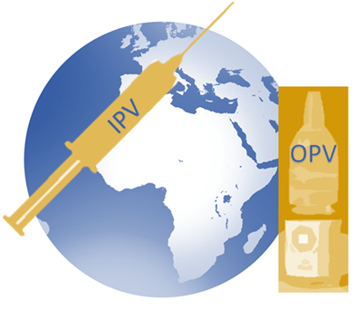
Inactivated Polio Vaccine (IPV) Rationale for IPV introduction & OPV withdrawal in relation to Objective 2 of The Polio Eradication & Endgame Strategic Plan
Immunization Systems Management Group (IMG)
Dhaka, Bangladesh
February 27, 2014
Notes:
1
© 2012 IMG

Slide 2
Objectives of this session
Review of SAGE recommendations for IPV introduction
Provide technical rationale for IPV introduction as it relates to Objective 2

Slide 3
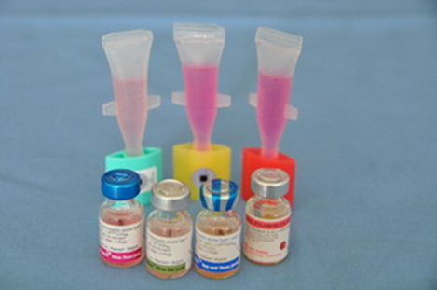
Oral Polio Vaccines (OPV) in routine and supplementary immunization activities globally
Types of OPV
Trivalent OPV (tOPV): types 1, 2, and 3
Bivalent OPV (bOPV): types 1 and 3
Monovalent OPV (mOPV): types 1 or 2 or 3
Currently, TRIVALENT is the most commonly used OPV in routine immunization globally, while BIVALENT is more commonly used in supplementary immunization activities.

Slide 4
Types of polioviruses
Wild
99% reduction in cases of wild poliovirus since 1988
Type 1 (341 cases as of 20 November 2013†)
Type 2 (eliminated worldwide in 1999)
Type 3 (none detected since November 2012)
VAPP**
Vaccine-associated paralytic poliomyelitis (VAPP)**
Estimated ~250-500 globally per year
Type 2 accounts for about 40% of VAPP
OPV related
VDPVs*
Vaccine derived polioviruses (VDPV)
Most are circulating VDPVs (cVDPVs)*
~49-184 per year since 2008 (through 20 Nov 2013)
Type 2 cVDPVs account for 97% of cVDPVs
† More up-to-date numbers can be found at http://www.polioeradication.org/Dataandmonitoring/Poliothisweek.aspx
*Other extremely rare VDPVs include primary immunodeficiency VDPVs (iVDPVs) and ambiguous VDPVs (aVDPVs)
**Refers to spontaneous reversion to neurovirulence of one of the attenuated viruses in OPV. VAPP occurs in OPV recipients or their close contacts in contrast to cVDPVs which are widely transmitted in a community and are not likely to be related to contact with a recent vaccine recipient.

Slide 5
GPEI Accomplishment: Significant Decline in Polio-paralyzed Children, 1988-2013*
*as of 31 December 2013

Slide 6
As wild polioviruses are eradicated, number of vaccine-derived cases exceeds wild poliovirus cases
A hypothetical scenario of estimated VDPV cases compared to reported cases of wild poliovirus (as of 31 December, 2013)

Slide 7
What does it mean for the world to be polio-free?
Complete interruption of transmission and elimination of all polio disease
Wild polioviruses
Vaccine-derived polioviruses (VDPVs)
Vaccine-associated paralytic poliomyelitis (VAPP)
Eradication & Endgame Strategic Plan 2013-2028 refers to both wild and vaccine-derived polioviruses
Eradication
Endgame
Plan refers to wild virus
Plan refers to management of VDPVs and VAPP

Slide 8
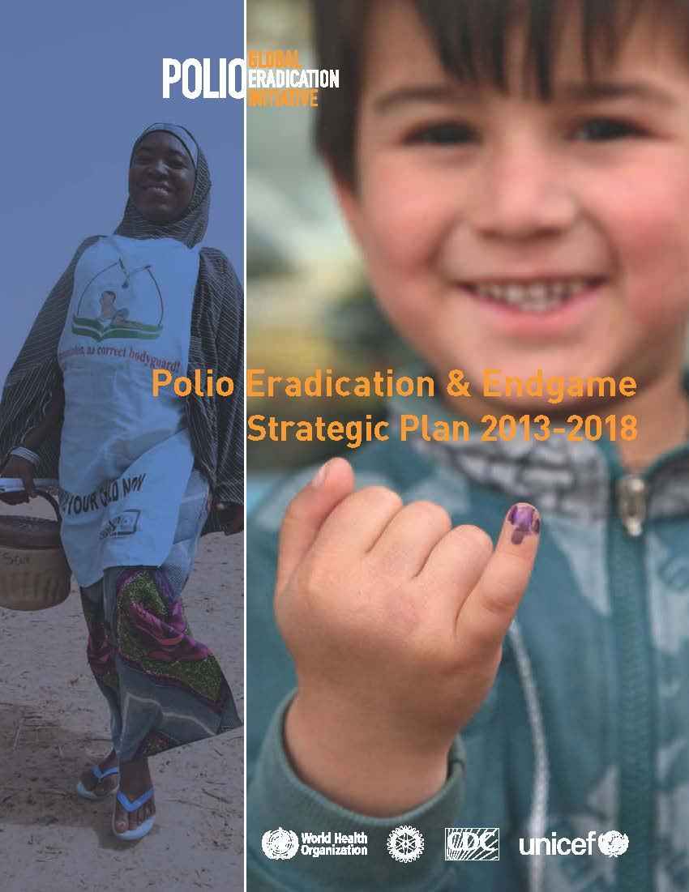
The Polio Eradication & Endgame Strategic Plan 2013-2018
The Plan differs from previous eradication plans
“complete the eradication and containment of all wild, vaccine-related, and Sabin polioviruses such that no child ever again suffers paralytic poliomyelitis.”

Slide 9
Technical Rationale for Oral Polio Vaccine (OPV) Cessation
Key Messages
Because OPV in rare cases can cause paralytic disease, OPV cessation must occur for the world to be polio free.
OPV cessation will occur globally in two phases:
removal of type 2 component (switch from tOPV to bOPV) in 2016
followed by bOPV withdrawal and cessation of OPV use in 2018-2019.

Slide 10
Rationale for continuing use of OPV until Polio Eradication & Global Certification
Wild poliovirus still circulating
As long as there are susceptible persons in other countries, there is risk of export of the virus to these countries.”
Endemic in 3 countries – reservoirs for re-infecting others (Pakistan, Afghanistan, Nigeria)
In 2013, polio cases in 5 other countries previously polio free countries (Somalia, Kenya, Ethiopia, Cameroon, Syria)
Eradication requires OPV
OPV is a critical component of the eradication strategy until polio transmission is interrupted globally & the world is certified polio-free,
Risk of polio spread into other regions of the world is real without the continued use of OPV
OPV is appropriate for eradication
Inexpensive
Easy to administer
Offers good oral and intestinal immunity—needed for interruption of person to person transmission

Slide 11
Objective 2 of the Plan calls for a phased withdrawal and containment of OPV globally
OPV withdrawal
Phase 1
2016
Type 2
Remove type 2 by switch from tOPV to bOPV…
Phase 2
2019-2020
All OPV
…followed by bOPV withdrawal and cessation of OPV use in 2019-2020

Slide 12
Rationale for removing type 2 component of OPV (OPV2)
Risks of OPV2 far outweigh the benefits
Thus, need to remove OPV2, but need to maintain population immunity against type 2 with IPV prior to OPV2 cessation
Type 2 poliovirus apparently eradicated since 1999 (last case detected in Aligarh, India)
New diagnostics and experience suggest that type 2 cause >95% of cVDPVs
Type 2 causes 40% of VAPP today
Type 2 component of OPV interferes with immune response to types 1 and types 3

Slide 13
Rationale for retaining Types 1 & Types 3 components of OPV (bivalent OPV) until global certification of polio eradication
Type 1 causes all polio cases related to wild virus today
Few VDPV cases are type 1
Few VAPP cases in immunocompetent individuals
Type 3 last detected in November, 2012 (as of 20 November 2013)
Few VDPV cases are type 3
Most VAPP cases (60%) in immunocompetent persons are type 3
While lack of detection since November 2012 is promising, the period without detection to date is not long enough to assume eradication—due to potential silent transmission, certification of eradication requires at least 3 years without detection of virus.

Slide 14
Risks associated with OPV2 cessation
Two main risks are associated with OPV2 cessation
These risks are mitigated by strengthening routine immunization and introduction of IPV
Short-term risks
Time-limited risk of cVDPV2 emergence, highest 1-2 years after OPV2 cessation
Medium & long term risks
Poliovirus re-introduction from a vaccine manufacturing site, research facility, immune deficient persons, diagnostic laboratory, or bioterrorism

Slide 15
Role of OPV post-eradication
POLIO
OUTBREAK post-eradication
mOPV1
mOPV2
mOPV3
Maintaining a stockpile of monovalent OPVs (mOPV1, mOPV2, mOPV3)
Using mOPVs to control outbreaks of cVDPVs or re-introduction from a manufacturing site, research facility, or diagnostic laboratory
Stockpile of mOPVs would allow a type-specific response for rapid interruption of outbreak

Slide 16
Technical Rationale for Introduction for Inactivated Polio Vaccine (IPV)
Key Messages
Introducing IPV before the tOPV-bOPV switch in 2016 will ensure that a substantial proportion of the population is protected against type 2 polio after OPV2 cessation and mitigate risks associated with OPV2 cessation
IPV is recommended for routine immunization programmes & not campaigns
IPV is given in addition to OPV doses and does not replace any OPV doses

Slide 17
What is the new endgame?
Strategic framework for finishing and securing polio eradication. Includes plan for:
Eradicating last foci of wild poliovirus circulation
Step by step removal of OPV poliovirus (Sabin strains), starting with OPV type 2
Introducing IPV in routine immunization in all countries
Active strengthening of routine immunization
Polio program legacy
What does removal of OPV type 2 means?
OPV type 2 removal means that tOPV (OPV with all three types) will be replaced with bOPV (OPV with only type 1 and type 3)
Change from tOPV to bOPV MUST be synchronized globally – all countries have to stop using tOPV at the same time
Because all children born after the switch to bOPV will be susceptible to polio type 2, at least one dose of IPV is added to the routine EPI (starting >6 months before switch from tOPV to bOPV).
The highest risk of VDPV 2 emergence and outbreak will be six months after the switch

Slide 18
Planned use of IPV: SAGE Recommendations
SAGE recommended that all countries introduce at least 1 dose of IPV in their routine immunization programmes to mitigate the risks associated with the withdrawal of type 2 component of OPV
Single dose of IPV at 14 weeks of age with DTP3, in addition to OPV3 or OPV4.
Countries have flexibility to consider alternative schedules
All endemic and other high risk countries should develop a plan for IPV introduction by mid-2014 and all OPV-only using countries by end-2014
WER, 3 Jan 2014, vol. 89, 1 (pp 1-20): at http://www.who.int/wer/2014/wer8901/en/index.html

Slide 19
Example 6-10-14 week schedule with IPV
Vaccine | Birth | 6 weeks | 10 weeks | 14 weeks
BCG | √
DTP-HepB-Hib |  | √ | √ | √
Pneumococcal |  | √ | √ | √
Rotavirus* |  | √ | √ | √
OPV |  | √ | √ | √
Stand-alone IPV |  |  |  | √
1st contact after 14 weeks
Single dose of IPV at 14 weeks or first contact afterwards
All children who are behind on their schedule should receive one dose of the IPV at the first immunization contact after 14 weeks
* Rotavirus vaccine may be administered in 2 or 3 doses, depending on the country schedule

Slide 20
Objective 2 of The Plan addresses the Endgame through three distinct stages
Introduce
Switch
Withdrawal
at least one dose of IPV
tOPV to bOPV
of bOPV & routine OPV use
into routine immunization
2019-2020
2016
Before end
2015
Ongoing STRENGTHENING of routine immunization services

Slide 21
Features of Inactivated Polio Vaccine (IPV)
Not a live vaccine – no risk of VAPP or VDPVs
Must be administered by intramuscular or subcutaneous injection
Trivalent – produces antibodies to types 1, 2 and 3 poliovirus
A high proportion of vaccinees, generally > 95% of children, have serum neutralizing antibodies after 3 doses to all three polio serotypes
>95% seroconvert or are primed after one dose of IPV
Provides risk mitigation
Will priming equate to protection?

Slide 22
Rationale for introducing at least one dose of IPV prior to the tOPV-bOPV switch
Fundamentally, introducing IPV before the tOPV-bOPV switch in 2016 will ensure that a substantial proportion of the population is protected against type 2 polio after OPV2 cessation.
Reduce risks
Hasten eradication
Interrupt transmission if outbreaks occur
IPV
Notes:
At least 1 dose of IPV used globally would improve population immunity
Reduces the consequences of type 2 re-emergence by inducing population immunity
Seroconversion* is generally 32-65% for the first dose of IPV
Virtually all who do not seroconvert are still immunologically primed** and may be protected against clinical polio
In the event of a type 2 polio outbreak as a result of reintroduction of the type 2 viruses
a significant proportion of children who have received IPV would already be immune
a dose of mOPV2 in an SIA for outbreak response would lead to higher immunity levels in a population that has received 1 dose of IPV previously than use of mOPV2 in a naïve population because these children will have received 2 doses of a polio containing vaccine instead of just the 1 dose administered in an SIA
IPV boosts systemic immunity (protects against paralytic disease) and intestinal immunity (reduces transmission) in OPV primed populations to all vaccine types contained in prior OPV doses - i.e. it will boost immunity to types 1 and 3, hastening interruption of transmission and providing insurance against reintroduction from other populations.

Slide 23
Individual protection against paralytic disease induced by IPV – REDUCE RISKS
Reduce risks
Hasten eradication
Interrupt transmission if outbreaks occur
IPV

Slide 24
Impact of one dose of IPV*
Seroconversion against type 2 after one dose of IPV ranges from 32-63%; when administered at 4 months of age, 63% seroconvert.
In a study from Cuba, among those who did not seroconvert after 1 dose of IPV, 98% had a priming response to a subsequent dose of OPV--that is, they developed significant antibody responses within 7 days of subsequent exposure to OPV.
Persons who seroconvert should be protected against paralytic polio data are conflicting as to whether priming alone is protective.
IPV administered at 4 months of age | (n=153)
1st dose seroconversion | 63%
Priming | 98%
1st dose seroconversion & priming | 99%
* Estı´variz CF et al. Lancet 2012; 12(2):128-35

Slide 25
Rationale for administering IPV after 14 weeks of age, in the context of the Endgame Plan
It is important to note that immune response to one dose of IPV is substantially higher, particularly against Type 2 poliovirus (63%) when administered at 4 months of age compared to 6 weeks to 2 months of age (32%-39%).
Higher immune response at older age due to less interference from maternal antibody
Thus, SAGE recommends a single dose of IPV at 14 weeks or first contact afterwards, or with DTP3/OPV3

Slide 26
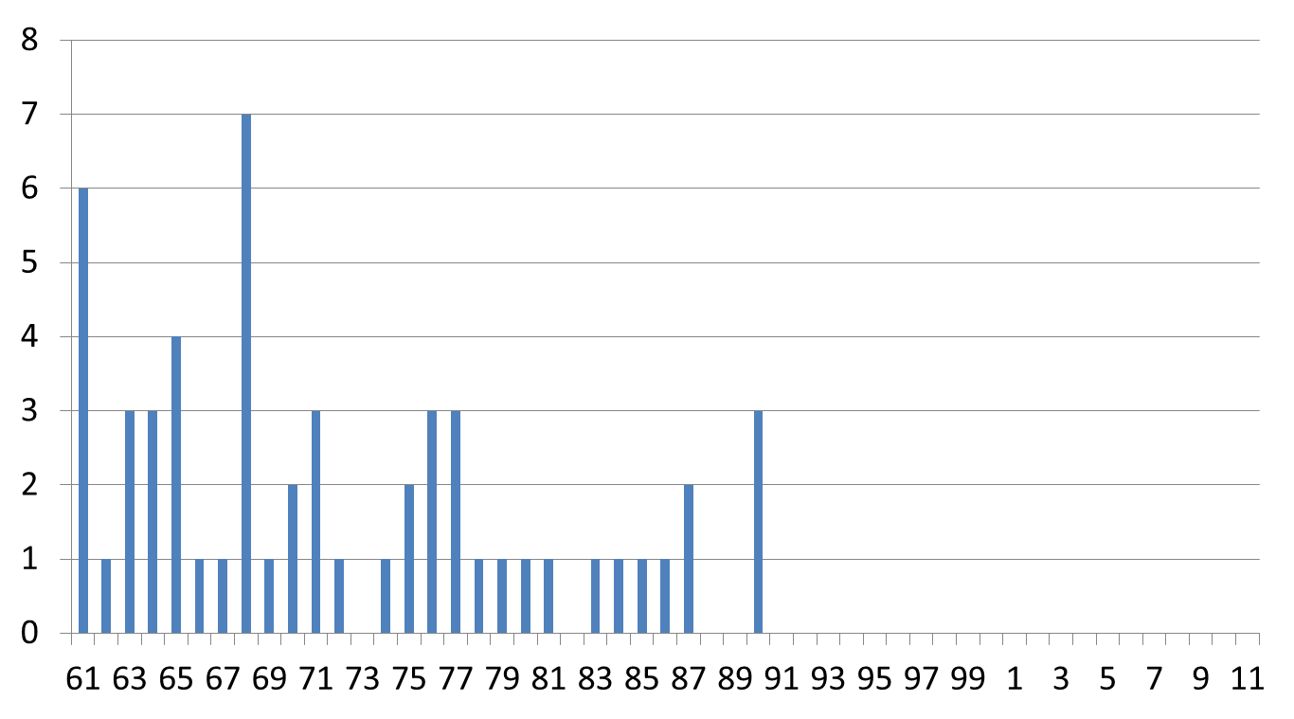
IPV Evidence: One IPV dose prevents VAPP in Hungary. Implies priming induces clinical protection.
In 1992,
single-dose
IPV at 3 mos of age,
before OPV receipt
VAPP number of cases
In 2006,
IPV-only
schedule
Year
Sutter RW – Presentation to SAGE IPV Working Group June 2013
In contrast, effectiveness against type 1 in Senegal was 36% (0%-67%) implying that seroconversion is the predictor of immunity.

Slide 27
IPV in reducing transmission of polioviruses – Interrupt Transmission
Reduce risks
Hasten eradication
Interrupt transmission if outbreaks occur
IPV

Slide 28
OPV challenge studies: Shedding of poliovirus in IPV versus OPV vaccinees
IPV is equivalent to OPV in reducing oral shedding but is inferior to OPV in reducing intestinal shedding.
IPV does reduce the duration of shedding and the amount of virus shed in the stool.
Thus, IPV should decrease the spread of polioviruses if they are introduced, compared to a fully unvaccinated population.
Faster outbreak control would also occur in an IPV vaccinated community because the population immunity would be closer to herd immunity threshold compared to an unvaccinated community.
From Vidor E et. al, Poliovirus Vaccine – Inactivated, Vaccines 6th edition, Elsevier, 2013

Slide 29
IPV in boosting immunity in OPV primed individuals – Hastens Eradication
Reduce risks
Hasten eradication
Interrupt transmission if outbreaks occur
IPV

Slide 30
A single dose of IPV after prior doses of tOPV boosts immunity to types 1 & 3
Data from Cote d’Ivoire and Moradabad, India indicate that IPV could also play a role in the eradication efforts, in conjunction with bOPV, by boosting immunity against type 1 and 3 polioviruses in polio endemic countries and countries where poliovirus circulation has been reestablished.
Among those infants who are seronegative after 3 doses of tOPV, immune response to Types 1 & 3 significantly better with IPV at 6 months of age in children*
 | 3 tOPV + IPV** | 3 tOPV + tOPV**
Type 1 seroconversion | 80% | 40%
Type 3 seroconversion | 76% | 22%
** Fourth dose at 6 months
*Moriniere BJ et al. Lancet 1993;341:1545-50, ** Estı´variz CF et al. Lancet 2012; 12(2):128-35,

Slide 31
Impact of IPV vs. OPV booster after OPV3 in seronegative individuals at 9 months of age, Côte d'Ivoire (Lancet, 1993)
IPV closes the immunity gaps in OPV-vaccinated infants
Percent

Slide 32
IPV boosts mucosal immunity in OPV-vaccinated infants and children
Impact of IPV vs. bOPV booster, Moradabad, India, 2012
40
50%
6-11 months
30
5-6 years
P1 excretion after day 28 challenge (%)
75%
20
10-11 years
10
0
bOPV
IPV
bOPV
IPV
bOPV
IPV
No Vaccine
No Vaccine
No Vaccine
Day 31
Day 35
Day 42

Slide 33
Summary of technical rationale for introducing at least one dose of IPV prior to the tOPV-bOPV switch
Introducing IPV before the tOPV-bOPV switch in 2016 will ensure that a substantial proportion of the population is protected against type 2 polio after OPV2 cessation. One dose of IPV will:
Reduce risks
Hasten eradication
Interrupt transmission if outbreaks occur
Reduce risks associated with OPV2 cessation
Lower risk of re-emergence of type 2 polioviruses
Facilitate interruption of transmission with the use of monovalent OPV2 if type 2 outbreaks occur
Boost immunity against types 1 & 3 thus hastening polio eradication
IPV
Notes:
At least 1 dose of IPV used globally would improve population immunity
Reduces the consequences of type 2 re-emergence by inducing population immunity
Seroconversion* is generally 32-65% for the first dose of IPV
Virtually all who do not seroconvert are still immunologically primed** and may be protected against clinical polio
In the event of a type 2 polio outbreak as a result of reintroduction of the type 2 viruses
a significant proportion of children who have received IPV would already be immune
a dose of mOPV2 in an SIA for outbreak response would lead to higher immunity levels in a population that has received 1 dose of IPV previously than use of mOPV2 in a naïve population because these children will have received 2 doses of a polio containing vaccine instead of just the 1 dose administered in an SIA
IPV boosts systemic immunity (protects against paralytic disease) and intestinal immunity (reduces transmission) in OPV primed populations to all vaccine types contained in prior OPV doses - i.e. it will boost immunity to types 1 and 3, hastening interruption of transmission and providing insurance against reintroduction from other populations.

Slide 34
Key messages for IPV introduction & OPV cessation
IPV recommended by SAGE
All countries introduce at least one dose of IPV into the routine immunization system before the tOPV-bOPV switch
OPV cessation crucial
OPV cessation must occur for the world to be polio free because OPV in rare cases can cause paralytic disease
OPV cessation--2 phases
Removal of type 2 in 2016 (tOPV to bOPV switch globally)
bOPV cessation in 2018-2019 (complete cessation of OPV)
IPV rationale
Ensures that a substantial proportion of the population is protected against type 2 polio after OPV2 cessation
Added IPV benefits
Mitigates risks of type 2 reintroduction in association with OPV2 cessation & facilitates polio eradication by boosting immunity to types 1&3
IPV clarifications
Recommended for routine immunization…not campaigns
Recommended in addition to OPV…not replacing any OPV

