Slide 1
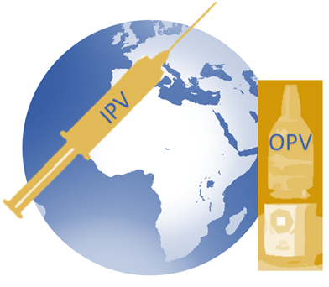
Inactivated Polio Vaccine Safety Modified version of Global Advisory Committee on Vaccine Safety (GACVS) Presentation on Dec 11, 2013
Immunization Systems Management Group (IMG)
Version date: March 21, 2014
Notes:
1
© 2012 IMG

Slide 2
Outline
Key Messages
Early Studies, Licensure and History
Modern IPV
Data Supporting IPV Safety
Safety Studies of IPV
Adverse Event Reporting in the US
IOM Safety Reports
Multiple Injections: Safety, Acceptability and Country Experience
Global Advisory Committee on Vaccine Safety (GACVS)
Summary of Safety Data
Future of IPV

Slide 3
Key Messages
Inactivated Polio Vaccine (IPV) was licensed in 1955 and underwent early reformulations to enhance potency and ensure safety in standalone and combination vaccines
IPV is one of the safest vaccines in humans, whether used alone or in combination vaccines
No serious adverse events have been reported
Only minor side effects
Adverse reactions from standalone or combination IPV are not significantly different from DTP
There is no relation between IPV and serious outcomes
The Polio Eradication and Endgame Plan calls for IPV
introduction and OPV type 2 withdrawal in the near future
and new strategies are needed to reduce costs and
hasten eradication

Slide 4
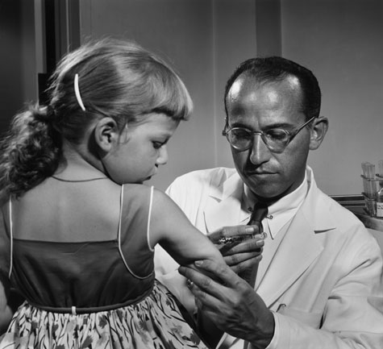
Early studies and licensure
The first polio vaccine was developed by Jonas Salk and first tested in 1954
IPV was licensed for use in the United States, Canada, and Western Europe in 1955 and was the only polio vaccine available until licensure of Oral Polio Vaccine (OPV) in 1961–1962
Early studies
Tested in a massive field trial that involved 1.8 million schoolchildren (“polio pioneers”)
The calculated efficacy of the early vaccine was 80-90% against paralytic polio and 60-70% against all forms of polio
Soon after Salk's vaccine was licensed in 1955 children's vaccination campaigns were launched
Kew et al, Annu Rev Microbiol 2005; Vidor, Vaccines, 2013; MOD website 2013; Offit, NEJM, 2005;
Atkinson et al, (The Pink Book) 2012; Kew, et al, Annu Rev Microbiol 2005; Vidor, Plotkin, Vaccines, 2013

Slide 5
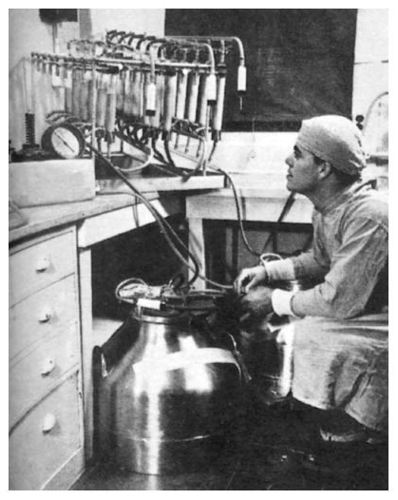
Cutter Incident- 1955
Investigations revealed that the vaccine, manufactured by Cutter Laboratories, had caused:
61 cases of VAPP
80 family contact cases
17 community contact cases
11 deaths
Subsequent studies found that cell debris contained in Cutter's vaccine had prevented adequate exposure of virus particles to formaldehyde.
The federal requirements for vaccine manufacture were revised, and between 1955 and 1962, a total of 400 million doses of safe, inactivated polio vaccine were distributed in the United States; the incidence of polio decreased dramatically.
3/24/2014
Offit, NEJM, 2005; Fitzpatrick, JRSM, 2006
Notes:
The Cutter incident resulted in the first coordinated national response to a medical emergency and in the creation of a better system of regulating vaccines. But the incident's final ironic legacy may lie in a court ruling that, although designed to protect children from harm, has greatly reduced the willingness of pharmaceutical companies to make lifesaving vaccines.

Slide 6
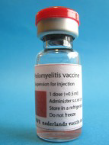
Modern IPV
After the Cutter incident, conditions for IPV manufacture were modified to ensure inactivation, resulting in a reduction in the immunogenicity of IPV preparations
However, improvements in cell culture technology in the 1970s led to the development of an enhanced-potency IPV, similar in immunogenicity to the original product which has replaced the second generation IPV
Now IPV is offered as an individual vaccine as well as in combination vaccines for primary immunization (10 products) and for boosters (more than 5 products).
Kew, et al, Annu Rev Microbiol 2005; SDIP, 2009

Slide 7
Safety studies of IPV*
When used alone IPV is well-tolerated.
In a French study, 5.5% of all injections were accompanied by an induration or by erythema and 4.6% caused general reactions
In a US study, fever (temperature, >=38.1°C) was reported in 10% of the children after the first dose, in 18% after the second dose and in 7% after the booster dose
When IPV was administered in association with DTP or was combined with DTP (DTP-IPV), the observed reactogenicity was comparable with that expected after vaccination with DTP alone
In a recent US study, rates of local reactions were similar in recipients of either DTP or DTP-IPV
This trial also demonstrated that 1- and 0.5-ml injections were equally well tolerated in infants
*Vero-produced IPV
-Vidor et al, Pediatr Infect Dis J., 1997;

Slide 8
Polio Prevention in the US: Introduction of A Sequential Vaccination Schedule of IPV Followed by OPV*
Adverse Events
No serious side effects of enhanced-potency IPV have been documented.
Because IPV contains trace amounts of streptomycin, polymyxin B, and neomycin, hypersensitivity reactions may occur among persons sensitive to these antibiotics.
*MMWR, 1997 Jan 24;46(RR-3):1-25.
Notes:
http://www.cdc.gov/mmwr/PDF/rr/rr4603.pdf
need to be sure to point out that 2-5/yr in sequential schedule is a projection based on distribution of recipient and contact cases

Slide 9
US Vaccine Adverse Events Reporting System (VAERS)
VAERS reports (1991–98) of IPV and OPV, assessing the impact of sequential vaccination for infants ages 1–3 and 4–6 months
Reporting did not increase significantly with shift to IPV use
Severity profiles for IPV and OPV similar for first and second dose
Most frequently reported symptoms were similar
Allergic reaction reported at higher frequency for IPV but no anaphylaxis
Five VAPP cases reported for OPV
VAERS reports (1999-2012) for all ages and both ‘Serious’ and ‘Non-serious’ events included
Most reported adverse events were non-serious
<1% reports were for single antigen IPV given alone
Pneumococcal, Hib, HBV, DTaP and Rotavirus most commonly reported vaccines co-administered
SIDS most commonly coded reason for deaths in infants
IOM review (2003) rejected a causal relationship between SIDS and multiple vaccines
No concerning safety issues in this review of adverse events reported for US IPV containing vaccines in VAERS, 1999– 2012

Slide 10
Epidemiology and Prevention of Vaccine-Preventable Diseases The Pink Book: Course Textbook - 12th Edition Second Printing (May 2012)
Atkinson et al, (The Pink Book) 2012.

Slide 11
Summary of Studies Adverse Event Reporting and Evidence of Safety in IPV
McBean et al, American Journal of Epidemiology, 1988
In a 3 year study starting in 1980 in Maryland, overall local adverse reactions with IPV+DTP were found to be not significantly different from those who received OPV+DTP (n=1,114). Three doses were administered at (mean age) 2.2, 4.7, and 19.9 months.
Yeh et al, Journal of Pediatric Infectious Disease, 2001
Combination vaccines containing IPV were compared with an OPV, Diptheria, Tetanus and acellular pertussis (DTaP) and Hepatitis B (HBV) series in California. No statistical differences in systemic and local adverse events were observed by chi square analysis for the four groups for any dose (n=1,116). Three doses were administered at 2, 4 and 6 months.
Quiambao et al, Human Vaccines & Immunotherapeutics, 2012
In the Phillipines among 312 two-year olds, the safety profile of three DTwP-HBV-IPV/Hib (combined) formulations resembled licensed DTwP-HBV/Hib and IPV (co-administered) in terms of the frequency and intensity of adverse reactions after vaccination.
Vidor et al, Reviews in Medical Virology, 1994
Review article: The safety of DTP/IPV was actively surveyed in five trials and descriptive data found that rates of reactions are comparable to those usually reported after DTP vaccination. No major adverse reactions nor vaccine associated poliomyelitis was notified during clinical trials.
Lee et al, Vaccine, 2011
In Korea, an RCT of 442 infants compared a combined DTaP–IPV to separate administration of standalone DTaP and IPV vaccines. Combined vaccine was well tolerated; most solicited events occurred soon after vaccination, were transient, and were of mild severity, and SAE were infrequent. There was no clinically significant difference in reactogenicity between the two groups, and there were no adverse event-related withdrawals and no vaccine-related SAE. The incidence of solicited and unsolicited symptoms observed in this study was similar to those reported in other studies of acellular pertussis vaccines.

Slide 12
Institute of Medicine (IOM) Reports
1994 IOM report
Evidence was inadequate to accept or reject a causal relation between IPV and Guillain-Barre Syndrome (GBS)
No evidence bearing on a causal relation between IPV and anaphylaxis
No evidence bearing on a causal relation between IPV and thrombocytopenia
2012 IOM report
DTaP-IPV vaccination does not increase the risk of type 1 diabetes in children
Stratton et al, IOM, 1994; Stratton et al, IOM, 2012

Slide 13
Multiple Injections: Acceptability and Safety
Recently, more low and middle income countries have begun using multiple vaccine injections with the addition of pneumococcal vaccine and IPV
Substantial evidence has reinforced the well-established record of safety and acceptance of multiple injections from countries using multiple injections*
For example, US, Brazil, South African infants often receive 3 or more injections during each of the primary series vaccination visits
Giving several vaccinations during same visit offers three major advantages:
Offers protection during the vulnerable early months of life
Reduces the number of vaccination visits
Improves healthcare provider efficiency
*http://www.cdc.gov/vaccinesafety/Vaccines/multiplevaccines.html
*http://www.cmaj.ca/content/182/18/E843.full

Slide 14
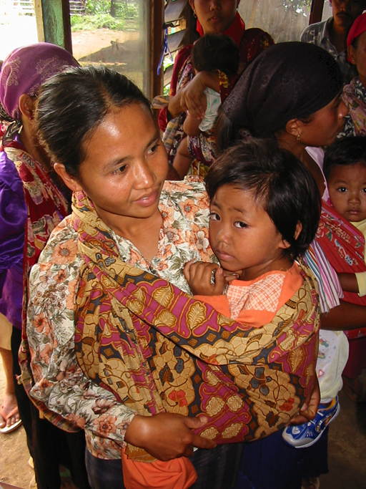
Country Experience with Multiple Injections and Safety
Brazil
IPV was the third injection in the EPI (with pentavalent and PCV)
Messages emphasized the safety and benefits of multiple injections during the same visit
Ministry of Health experience indicates that as a result of education and training, multiple injections well accepted by providers and healthcare workers
AEFI monitoring did not identify any increases in serious adverse events
Yogyakarta, Indonesia
Switched from OPV to four doses of stand-alone IPV in 2007 (2 injections vs. 1)
Emphasis on training and orientation of healthcare providers, and communication materials for caretakers about tolerability of these injections without adverse consequences
No adverse events reported after the switch to IPV

Slide 15
Global Advisory Committee on Vaccine Safety (GACVS)*
Met on 11 December 2013 to review the safety profile of IPV (stand-alone and combination):
Safety track record of IPV in clinical trials
AEFI reports related to IPV in the VAERS in the US
Issues related to manufacturing process
GACVS concluded:
Known adverse events are primarily non-serious events
Local reactions similar to those seen with all inactivated vaccines
Reviews have not documented any serious adverse events causally related to IPV
“Based on available data, GACVS was reassured that IPV and IPV-containing vaccines have an excellent safety profile”
*To be published, WER 14 Feb 2014

Slide 16
Summary: General Safety Profile
Known adverse events of IPV administered alone are primarily non serious reactions. Local reactions are most common and are classically seen with all inactivated vaccines.
Local erythema (1%), induration (3-11%), tenderness (14-29%)
Adverse events of IPV administered as a combination with other vaccines are difficult to differentiate from adverse events induced by the other vaccines (e.g. whole cell DTP)
Reviews have not documented any serious adverse events causally related to IPV.
IPV administered before OPV reduces Vaccine Associated Paralytic Polio (VAPP) cases compared with OPV alone

Slide 17
Future of IPV
Polio Eradication and Endgame Plan
Withdrawal of type 2 from OPV and eventually stopping use of all OPV
Therefore, IPV will be the tool that
provides protection against type 2 virus during the transition
boosts immunity to types 1 and 3
hastens eradication and protects against all three strains of polio during the endgame
Due to the high cost of IPV relative to OPV, strategies are underway to reduce the cost by several methods
Salk antigen-sparing approaches including
Fractional dosing (1/3 or 1/5)
Use of adjuvants to reduce the poliovirus antigen content
Exploring use of Sabin strains
Would allow developing country manufacturers to make IPV at a lower cost

Slide 18
References
Epidemiology and Prevention of Vaccine-Preventable Diseases (The Pink Book). In: Atkinson W, Wolfe C, Hamborsky J, editors. Epidemiology and Prevention of Vaccine-Preventable Diseases: Centers for Disease Control and Prevention; 2012. p. 249-261.
Kew OM, Sutter RW, de Gourville EM, Dowdle WR, Pallansch MA. Vaccine-derived polioviruses and the endgame strategy for global polio eradication. Annual Review of Microbiology. 2005;59:587-635.
Vidor E, Plotkin SA. Poliovirus vaccine—inactivated. In: Plotkin SA, Orenstein WA, Offit PA, editors. Vaccines. 6th ed. Edinburgh: Elsevier/Saunders; 2013. p. 573-597.
Rose D. A history of the March of Dimes: The Polio Years. http://www.marchofdimes.com/mission/a-history-of-the-march-of-dimes.aspx. Published 2010. Accessed 11/26/2013, 2013.
Offit PA. The Cutter incident, 50 years later. The New England Journal of Medicine. 2005;352(14):1411-1412.
Langmuir AD, Nathanson N, Hall WJ. Surveillance of poliomyelitis in the United States in 1955. American Journal of Public Health and the Nation's Health. 1956;46(1):75-88.
San Diego Immunization Program. Vaccine Names and Abbreviations. http://www.sdiz.org/documents/HCP/iz78.pdf. Published 2009.
Vidor E, Meschievitz C, Plotkin S. Fifteen years of experience with Vero-produced enhanced potency inactivated poliovirus vaccine. The Pediatric Infectious Disease Journal. 1997;16(3):312-322.
McBean AM, Thoms ML, Albrecht P, Cuthie JC, Bernier R. Serologic response to oral polio vaccine and enhanced-potency inactivated polio vaccines. American Journal of Epidemiology. 1988;128(3):615-628.
Yeh SH, Ward JI, Partridge S, Marcy SM, Lee H, Jing J, et al. Safety and immunogenicity of a pentavalent diphtheria, tetanus, pertussis, hepatitis B and polio combination vaccine in infants. The Pediatric Infectious Disease Journal. 2001;20(10):973-980.
Quiambao B, Van Der Meeren O, Kolhe D, Gatchalian S. A randomized, dose-ranging assessment of the immunogenicity and safety of a booster dose of a combined diphtheria-tetanus-whole cell pertussis-hepatitis B-inactivated poliovirus-Hemophilus influenzae type b (DTPw-HBV-IPV/Hib) vaccine vs. co-administration of DTPw-HBV/Hib and IPV vaccines in 12 to 24 months old Filipino toddlers. Human Vaccines & Immunotherapeutics. 2012;8(3):347-354.
Vidor E, Caudrelier P, Plotkin S. The Place of DTP/eIPV Vaccine in Routine Paediatric Vaccination. Reviews in Medical Virology. 1994;4:261-277.
Lee SY, Hwang HS, Kim JH, Kim HH, Lee HS, Chung EH, et al. Immunogenicity and safety of a combined diphtheria, tetanus, acellular pertussis, and inactivated poliovirus vaccine (DTaP-IPV) compared to separate administration of standalone DTaP and IPV vaccines: a randomized, controlled study in infants in the Republic of Korea. Vaccine. 2011;29(8):1551-1557.
Cadorna-Carlos J, Vidor E, Bonnet MC. Randomized controlled study of fractional doses of inactivated poliovirus vaccine administered intradermally with a needle in the Philippines. International journal of infectious diseases : IJID : official publication of the International Society for Infectious Diseases. 2012;16(2):e110-116.
Murdin AD, Barreto L, Plotkin S. Inactivated poliovirus vaccine: past and present experience. Vaccine. 1996;14(8):735-746.
Poliomyelitis prevention in the United States: introduction of a sequential vaccination schedule of inactivated poliovirus vaccine followed by oral poliovirus vaccine. Recommendations of the Advisory Committee on Immunization Practices (ACIP). MMWR Recommendations and reports : Morbidity and mortality weekly report Recommendations and reports / Centers for Disease Control. 1997;46(RR-3):1-25.
Vaccine Safety Committee. IOM. Adverse Events Associated with Childhood Vaccines: Evidence Bearing on Causality 1994.
Vaccine Safety Committee. IOM. Adverse Events Associated with Childhood Vaccines: Evidence Bearing on Causality 2012.
Hviid A, Stellfeld M, Wohlfahrt J, Melbye M. Childhood vaccination and type 1 diabetes. The New England Journal of Medicine. 2004;350(14):1398-1404.
IOM (2003). Immunization Safety Review: Vaccinations and Sudden Unexpected Death in Infancy. Stratton et al. eds. National Academy Press, Washington DC.

