Slide 1
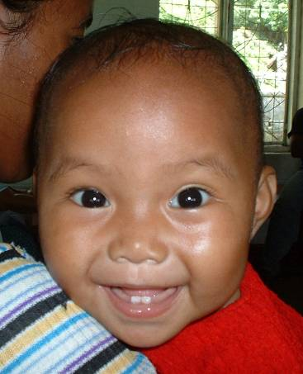
Orientation to Routine Immunization
An overview of routine immunization services

Slide 2
Recommended Routine Immunizations
For all
Tuberculosis (BCG) DTP (Diphtheria, Tetanus, Pertussis) Polio Measles Hepatitis B Haemophilus influenza b* Pneumococcal* Rotavirus* Rubella* Human Papillomavirus*
For high-risk populations
Typhoid Cholera Meningococcal Hepatitis A Rabies
For programs with certain characteristics
Mumps* Influenza (inactivated)
For certain regions
Japanese encephalitis (Asia) Yellow Fever (Sub-Saharan Africa, S. America)
* New and / or underutilized vaccine in some regions or countries
WHO, September 2011

Slide 3
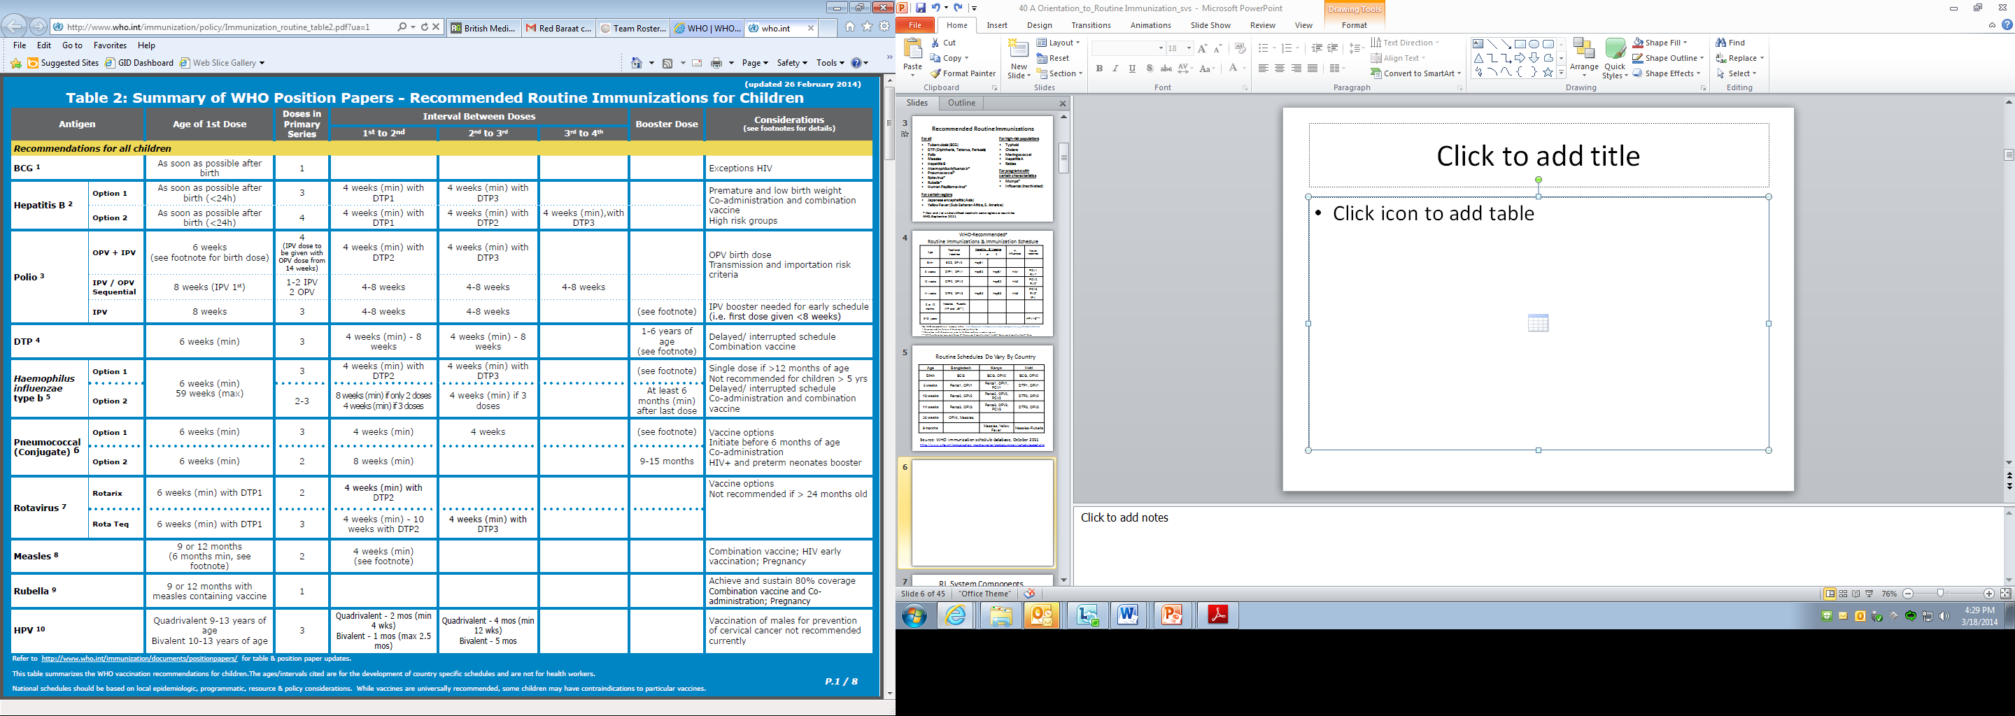

Slide 4
WHO-Recommended#
Routine Immunizations & Immunization Schedule
Age | Traditional Vaccines | Hepatitis B Vaccine 1 or 2 |  | H. Influenzae | Newer vaccines
Birth | BCG, OPV0 | HepB1
6 weeks | DTP1, OPV1 | HepB2 | HepB1 | Hib1 | PCV1, RV1*
10 weeks | DTP2, OPV2 |  | HepB2 | Hib2 | PCV2, RV2*
14 weeks | DTP3, OPV3 | HepB3 | HepB3 | Hib3 | PCV3, RV3* IPV
9 or 12 months | Measles, Rubella (YF and JE**)
9-13 years |  |  |  |  | HPV1-3***
#See WHO recommendation summary tables: http://www.who.int/immunization/policy/immunization_tables/en/index.html
* doses required for Rotarix; 2 doses required for Rota Teq
**Yellow fever and JE vaccine are given to children residing in certain regions
***HPV-quadrivalent requires 3 doses; 2nd dose given 2 months after 1st and 3rd dose given 4 months after 2nd dose.
Notes:
elivery of the second dose (MCV2) may occur either at a scheduled age through routine services or periodically through mass campaigns, depending on which strategy achieves the higher coverage. A MCV2 dose may be added to the routine immunization schedule in countries that have achieved > 80% coverage of measles first dose (MCV1) at the national level for 3 consecutive years as determined by the most accurate means available (e.g. survey or WHO/UNICEF estimates). In general, countries that do not meet this criterion should prioritize improving MCV1 coverage and conducting high-quality follow-up SIAs, rather than adding MCV2 to their routine schedule.
• In countries with ongoing transmission in which the risk of measles mortality remains high, MCV1 should be given at age 9 months. MCV2 should be given between 12-18 months, as providing MCV2 in the 2nd year of life reduces the rate of accumulation of susceptible children and the risk of an outbreak.
• In countries with low rates of measles transmission (that is, those that are near elimination) and where there is a low risk of measles infection among infants, the first dose may be administered at age 12 months to take advantage of the higher seroconversion rates achieved at this age (>90% seroconversion). In these countries the optimal age for delivering a routine 2nd dose of measles is based on programmatic considerations that achieve the highest coverage and hence the highest population immunity. Administration of the second dose at age 15-18 months ensures early protection of the individual, slows accumulation of susceptible young children and may correspond with other routine immunizations (for example, DTP booster). If first dose coverage is high (>90%) and school enrolment is high (>95%), giving the second dose at school

Slide 5
Routine Schedules Do Vary By Country
Age | Bangladesh | Kenya | Haiti
Birth | BCG | BCG, OPV0 | BCG, OPV0
6 weeks | Penta1, OPV1 | Penta1, OPV1, PCV1 | DTP1, OPV1
10 weeks | Penta2, OPV2 | Penta2, OPV2, PCV2 | DTP2, OPV2
14 weeks | Penta3, OPV3 | Penta3, OPV3, PCV3 | DTP3, OPV3
36 weeks | OPV4, Measles
9 months |  | Measles, Yellow Fever | Measles-Rubella
Source: WHO immunization schedule database, October 2011
http://www.who.int/immunization_monitoring/en/globalsummary/scheduleselect.cfm

Slide 6
What is the Routine Immunization System?
Vaccine Supply &
Quality
Logistics
Service delivery
Surveillance
Advocacy &
Communication

Slide 7
What is the Routine Immunization System?
Operations
1.
Vaccine supply & quality
2.
Logistics
3.
Services delivery
Management
Financing
4.
Surveillance
5.
Communication
Capacity building

Slide 8
What is the Routine Immunization System?
The Immunization System Environment
External
Environment
Health System
Immunization System
The Routine Immunization System
Finance
Planning & Management
Human Resources
&
Capacity Building
Immunization Service Delivery
Communications & Community Links
Vaccine Supply & Quality
Cold Chain & Logistics
Surveillance
Monitoring & Using Data for Action (Response)

Slide 9







What is the Routine Immunization System?
GLOBAL
GLOBAL
GLOBAL
GLOBAL
GLOBAL
GLOBAL
GLOBAL
NATIONAL
NATIONAL
NATIONAL
NATIONAL
NATIONAL
NATIONAL
NATIONAL
LOCAL
LOCAL
LOCAL
LOCAL
LOCAL
LOCAL
LOCAL
POINT OF VACCINATION
POINT OF VACCINATION
POINT OF VACCINATION
POINT OF VACCINATION
POINT OF VACCINATION
POINT OF VACCINATION
Inventory management
POINT OF VACCINATION
Inventory management
Inventory management
Inventory management
Inventory management
Inventory management
Inventory management
Sufficient supplies at health posts
Sufficient supplies at health posts
Sufficient supplies at health posts
Sufficient supplies at health posts
Sufficient supplies at health posts
Sufficient supplies at health posts
Sufficient supplies at health posts
Community engagement & demand creation
Community engagement & demand creation
Community engagement & demand creation
Community engagement & demand creation
Community engagement & demand creation
Community engagement & demand creation
Supply planning
Community engagement & demand creation
Community engagement
Supply planning
Supply planning
Supply planning
Supply planning
Supply planning
Supply planning
Individual
Individual
Individual
Individual
Individual
Individual
Supply chain & logistics
Supplies
Individual
Supplies
Supplies
Supplies
Supplies
Supplies
Supplies
Manufacturing
Manufacturing
Manufacturing
Manufacturing
Manufacturing
Manufacturing
Manufacturing
Storage and distribution
Storage and distribution
Storage and distribution
Storage and distribution
Storage and distribution
Storage and distribution
Storage and distribution
Health worker
Health worker
Health worker
Health worker
Health worker
Health worker
Health worker
Supervisors & FLWs
Supervisors & FLWs
Supervisors & FLWs
Supervisors & FLWs
Supervisors & FLWs
Supervisors & FLWs
Supervisors & FLWs
Procurement & distribution
Human resources for health
Procurement & distribution
Procurement & distribution
Procurement & distribution
Procurement & distribution
Procurement & distribution
Procurement & distribution
Motivation
Motivation
Motivation
Motivation
Motivation
Motivation
Motivation
National & sub-national program managers
National & sub-national program managers
National & sub-national program managers
National & sub-national program managers
National & sub-national program managers
National & sub-national program managers
National & sub-national program managers
Training & mentorship
Training & mentorship
Training & mentorship
Training & mentorship
Training & mentorship
Training & mentorship
Collection & use of data
Training & mentorship
Collection & use of data
Collection & use of data
Collection & use of data
Collection & use of data
Collection & use of data
Collection & use of data
-------------------- Supply chain data -------------------
-------------------- Supply chain data -------------------
-------------------- Supply chain data -------------------
-------------------- Supply chain data -------------------
-------------------- Supply chain data -------------------
-------------------- Supply chain data -------------------
-------------------- Supply chain data -------------------
Monitoring & use of data
National training / professional programs and supervision
National training / professional programs and supervision
National training / professional programs and supervision
National training / professional programs and supervision
National training / professional programs and supervision
National training / professional programs and supervision
Data to guide national decision making
National training / professional programs and supervision
Data to guide national decision making
Data to guide national decision making
Data to guide national decision making
Data to guide national decision making
Data to guide national decision making
Data to guide national decision making
National motivation
National motivation
National motivation
National motivation
National motivation
National motivation
National motivation
Performance management, training, leadership
Global indicators
Global indicators
Global indicators
Global indicators
Global indicators
Global indicators
Global indicators
Global guidelines
Global guidelines
Global guidelines
Global guidelines
Global guidelines
Global guidelines
Global guidelines
Political commitment
Financing and pricing
Enabling partner environment
POLITICAL COMMITMENT
POLITICAL COMMITMENT
POLITICAL COMMITMENT
POLITICAL COMMITMENT
POLITICAL COMMITMENT
POLITICAL COMMITMENT
POLITICAL COMMITMENT
FINANCING & PRICING
FINANCING & PRICING
FINANCING & PRICING
FINANCING & PRICING
FINANCING & PRICING
FINANCING & PRICING
FINANCING & PRICING
ENABLING PARTNER ENVIRONMENT
ENABLING PARTNER ENVIRONMENT
ENABLING PARTNER ENVIRONMENT
ENABLING PARTNER ENVIRONMENT
ENABLING PARTNER ENVIRONMENT
ENABLING PARTNER ENVIRONMENT
FINANCING & PRICING
ENABLING PARTNER ENVIRONMENT
POLITICAL COMMITMENT
ENABLING PARTNER ENVIRONMENT
Governance, stability, and national infrastructure essential to vaccination systems but out of scope here.
Courtesy of BMGF
System components

Slide 10
HUMAN RESOURCES

Slide 11
Human Resources
Ministry of Health
Immunization Team
WHO EPI Team
UNICEF Immunization Focal Points
NGOs
National Level
Staff include communication, routine, campaign, surveillance focal points, led by EPI team lead
Provide cross-cutting support
UNICEF usually procures vaccine
May have staff at multiple levels
District Health Team
EPI focal point
District Health Team surveillance focal point
District Level
Oversee reporting process, approves expenses, supervises health workers
Calculate district surveillance indicators; oversee facility surveillance focal points & system
Facility medical officer-in-charge
Health worker/Vaccinator
Facility Level
Oversee reporting process, approves expenses, supervises health workers
Usually VPD surveillance focal point
Provides vaccinations
Completes monthly reports, immunization register
Tracks performance via monitoring charts, other monitoring tools

Slide 12
Planning & Management

Slide 13
Immunization Plans
National level
  Comprehensive Multiyear Plan (cMYP)
  Annual EPI plan
  Other: Measles Rubella Elimination plan, Polio Eradication plan, Hepatitis B control plan, etc
Local Levels (district, facility levels)
  Microplans

Slide 14
Immunization Plans
CMYP
YEAR 1
YEAR 2
YEAR 3
YEAR 4
YEAR 5
Annual EPI Plan
Microplans
Microplans
Microplans
Microplans

Slide 15
Comprehensive Multiyear Plan (cMYP)
Strategic national immunization plan
Often a 5 year plan
Living document that adjusts to changing conditions
Generates empirically-based budgets requests
Provides up-to-date information for advocacy and reporting

Slide 16
Comprehensive Multiyear Plan (cMYP)
Main content areas
Situation analysis
Objectives and milestones
Planning strategies
Links to national, regional, and international goals
Activity timeline, monitoring, and evaluation
Cost & financing & resource mobilization
Putting cMYP into action

Slide 17
Annual EPI Plan
Developed within the context of cMYP
Should contain specific activities for the year to achieve goals of cMYP
Should involve sub-national levels and be developed with sub-national levels

Slide 18
Microplans
District microplans: consolidate information on facilities (target information, vaccine needs, expected performance)
Facility microplans: identify when, where, and how to hold immunization sessions throughout catchment area
Should be updated at least annually

Slide 19
Microplans
Microplans commonly include
  Catchment target population
  Vaccine forecast information
  List of villages with population and session type
  List of planned and held outreach sessions and applicable villages
  Map with distances, hard to reach areas, villages and their populations, outreach sites
  Social mobilization activities

Slide 20
Example facility microplan from India
Notes:
Outreach is an expensive intervention. Takes time to plan, to implement and takes resources. Where there are vehicles, they complain of too few people, where have a motorcycle, complain need a vehicle, where have a bike, complain that need a motorcycle. And some are on foot.
Respecting this program is now considered on of the key barriers to increasing coverage. Many don’t set a schedule, or set a date but do not show up. Mothers get discouraged and do not take the day off the next time.

Slide 21
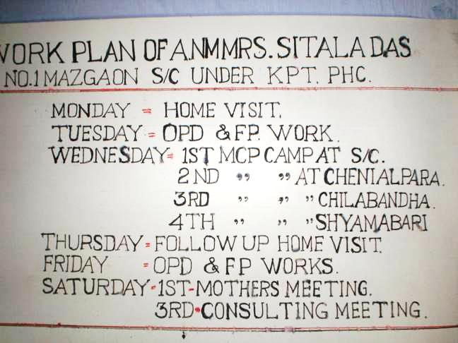
Example Workplan (India)

Slide 22
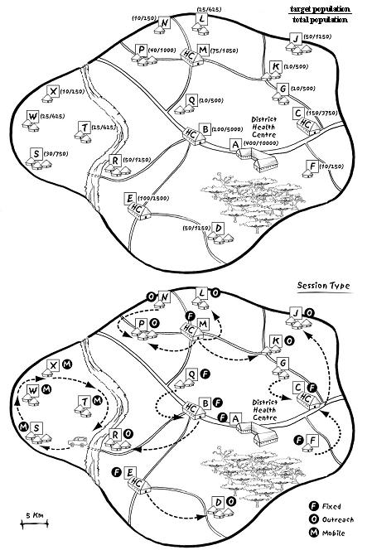
Planning: Catchment Area Map
Catchment area: service delivery area assigned to facility
Maps created by vaccinators and district focal points
Maps should include
Health facility location
Village locations, population, distance from HF
Session type for village
Cold chain storage points
Major area barriers

Slide 23
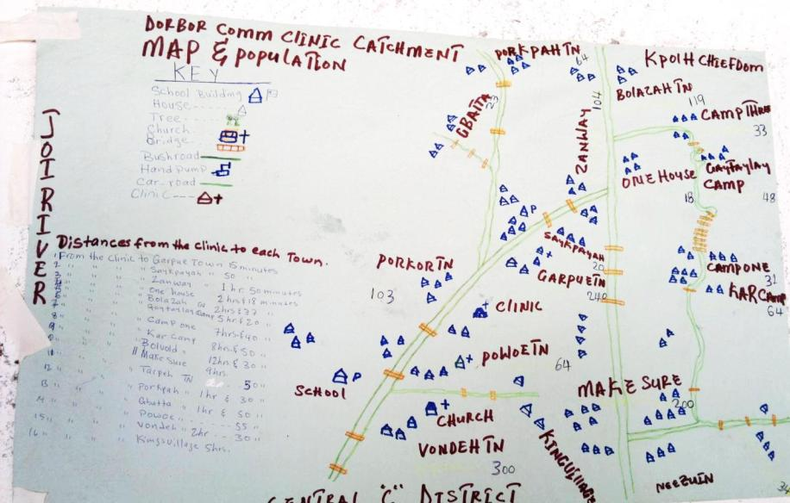
Example: Catchment map from Liberia

Slide 24
Target population
Defined as population which should receive all vaccines listed in country’s immunization schedule
Set by country’s immunization policy (EPI target age group often is children <1 of age)
Source usually from census data
  Some locations may conduct local headcounts when census data is considered inaccurate
Population numbers given to district, facility health staff to use for
  ordering vaccines, monitoring program performance and planning sessions
Notes:
Example: In one SE Asia country, the number of sessions was usually determined by # of villages (61.2%), # of nurses (42.2%), and number of beneficiaries (28.7%)

Slide 25
Supervision
Common national and district activity to ensure RI services are functioning
Objective: provide constructive feedback on performance and help remedy problems
Commonly involves checklist to cover all aspects of EPI

Slide 26
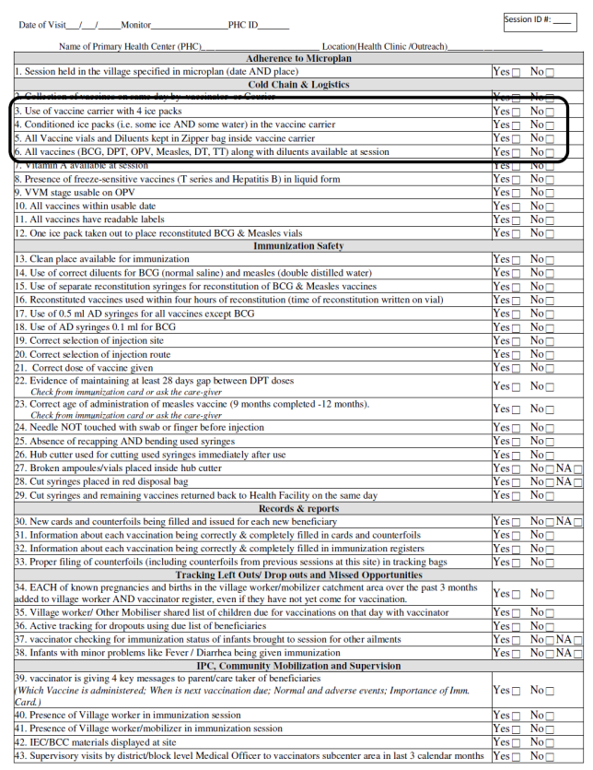
Supervision checklist often used to guide the supervision visit

Slide 27
Supervision checklist often used to guide the supervision visit

Slide 28
Supervision
District to facility supervision
  District visits facility EPI staff every few months
  District may also hold monthly/quarterly meetings of facility staff at district office
National to district supervision
  National level staff from MoH, partners (WHO, UNICEF) visit district health teams
Feedback to supervisee
  Written (preferred) in supervisory ledger or just verbal
  Copy of supervisory checklist results may be left with vaccinator
  Feedback should be followed up in next visit

Slide 29
Vaccine Supply & Quality
Cold chain, Injection safety, waste management, vaccine management

Slide 30
Routine Vaccine Forecasting
All levels (facility, district, national) forecast the number of doses required for each antigen during specific time period
Forecasted number used when requesting RI doses from next higher level
Vaccine forecast based on:
  Target population
  Wastage factor based on endorsed vaccine wastage rate
    “Wastage” is any dose not used to vaccinate a targeted person
    Countries set acceptable wastage rates e.g. the proportion of a vial which can be wasted due to various reason
    Measles, BCG, YF forecasts often use rates between 35-50%
    Pentavalent, Polio forecasts often use rates between 10%-30%
    Vaccine wastage factor formula = 100% / (100% – wastage rate)

Slide 31
Reasons for Wastage
Avoidable Reasons (Unopened vials) | Unavoidable Reasons (Opened vials)
Expiration of vaccine | Discard at end of RI session
Cold chain failure | Unused taken to outreach
Loss of vaccine | Unable to draw all doses
Vaccine breakage | Re-administration
Theft of vaccine | Suspected contamination
Poor reconstitution/ administration practices | Doses given to children outside target group
Notes:
open vial and acceptable wastage have many overlapping examples _ strong emphasis. when planning stock you need to account for the actual wastage levels.

Slide 32
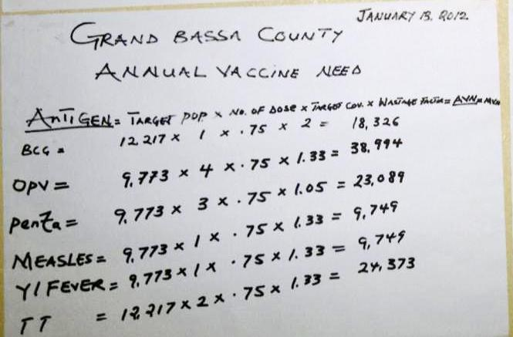
Example: vaccine forecast in Liberia

Slide 33
Managing vaccine supply
Requires tracking stock (supply) information
Routine stock management registers at each administrative level track the following:
  Number of vaccine doses received at level
  Number of vaccine doses used at level
  Current balance of doses at level
  Batch numbers, VVM status, expiry date of each vial

Slide 34
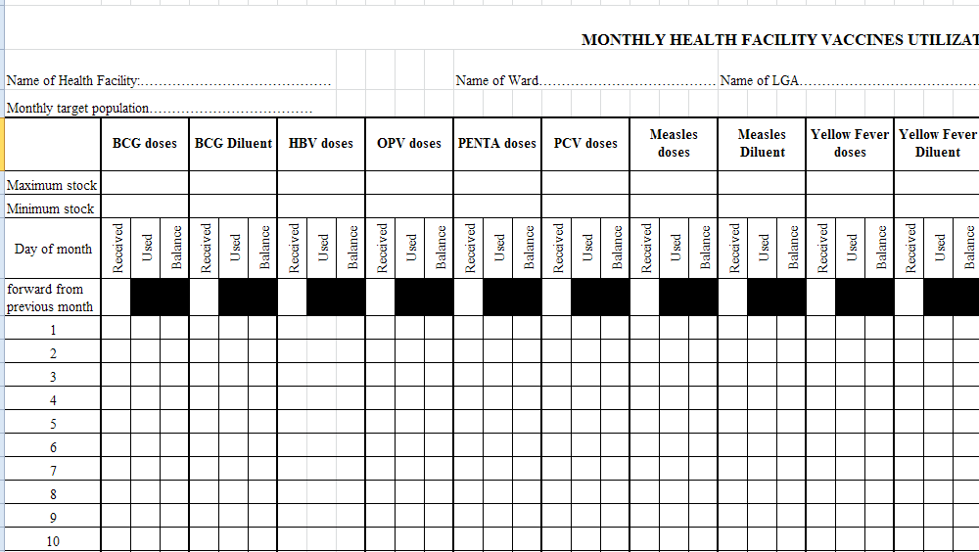
Example: stock management register from Nigeria

Slide 35
SERVICE DELIVERY: ConducTING IMMUNIZATION SESSIONS

Slide 36
Fixed Immunization Sessions
“Fixed” location = health facility
May happen daily or on specific days of week
Some vaccines may have special session day
  Common for reconstituted vaccines (BCG, Measles, YF) due to special usage requirement e.g. once vial is opened, can only be used for single day
  Children often “batched” to ensure low wastage (at risk of higher coverage)

Slide 37
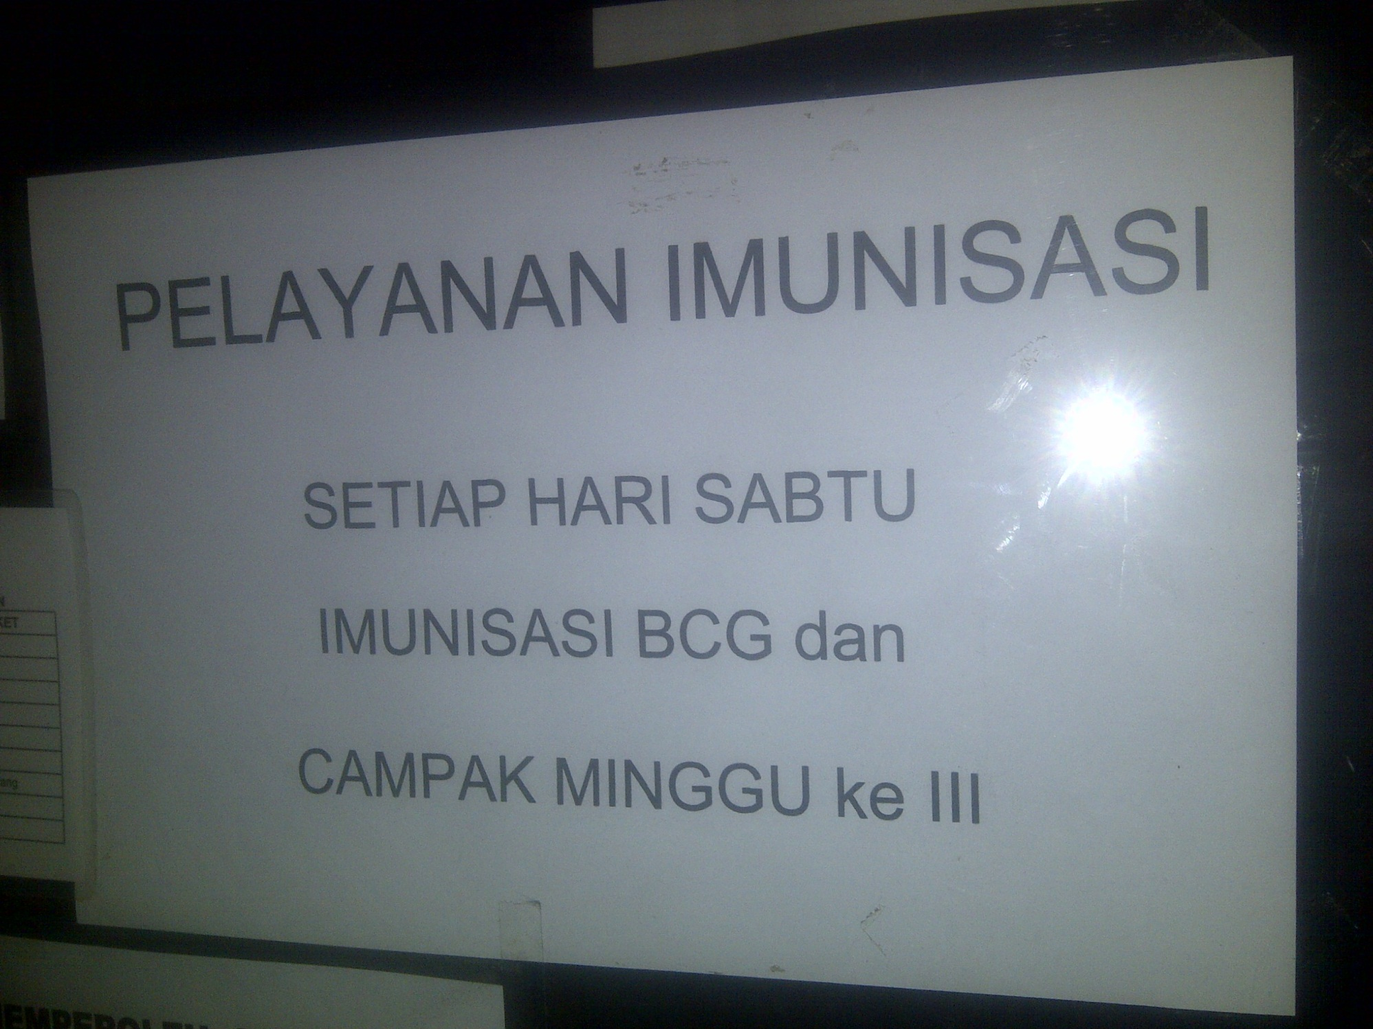
Session days-E Java, Indonesia
Service
Each Saturday
BCG and measles every third Saturday

Slide 38
Outreach Immunization Sessions
Conducted in communities far from health facility
Vaccinator usually has multiple outreach locations
Must be conducted at least 5x per year to each community (at least 5 immunization visits per yr)
Outreach session schedule
  Includes locations, dates, target population for each planned outreach sessions
Challenges
  Lack of fuel, transport, poor planning with community

Slide 39
COMMUNICATIONS: CREATING COMMUNITY DEMAND FOR RI

Slide 40
RI Communications Strategy
Village structures utilized to mobilize mothers for RI
  Village health volunteers
  Village chiefs
  Village health committees
  Town criers
Village structures used to support RI system
  Vaccine transport
  Planning location of outreach services
  Informing mothers of time and location of RI services
  Finding infants who have dropped out of RI services

Slide 41
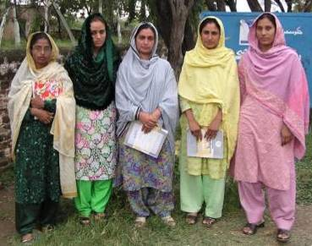
Community Links:
Lady Health Workers in Pakistan
Duties:
Birth registration
Defaulter follow-up
‘Catch-up’ routine immunization (including TT)

Slide 42
Key Communications Messages
During a vaccination visit
  Which vaccines were given
  When and where to return for next vaccination
  The potential adverse events that may occur
  Importance of vaccination
During a community meeting
  When and where outreach sessions should/will happen
  When and where fixed sessions happen
  “Special” vaccination days (e.g. for measles, BCG, YF)
  Importance of vaccination

Slide 43
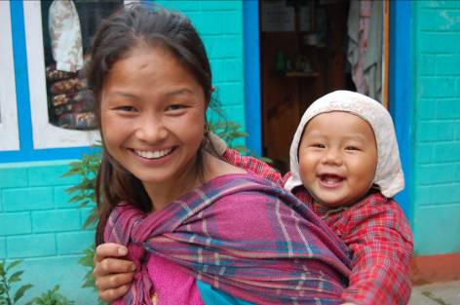
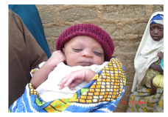
Strategies For Strengthening the Routine Immunization System

Slide 44
Common Barriers to High RI Coverage
Common reasons for low coverage
  Poor access
    Facility too far; no staff; no vaccine; no equipment
  High dropout / poor utilization
    Access factors; plus poor beneficiary-vaccinator communications
  Missed opportunities
    Wastage concerns; vaccination status not checked; vaccine stockouts
  Poor management
    Indequate resource management; no supervision; poor planning of immunization sessions
  Community barriers
    Poor social mobilization; vaccine refusals; no community participation

Slide 45
Reach Every District (RED) Strategy
Began in early 2000s in response to stagnant coverage levels
Primary objective when implementing RED: Ensure all RED components occur regularly

Slide 46
RED Strategy Components
Outreach
  Create maps, identify villages for outreach, create outreach plan, track sessions planned vs conducted
Supportive supervision
  Ensure supervision is two-way dialogue, solves vaccinator’s problems. Tracks visits planned versus conducted
Community Links
  Maintain regular dialogue with village leaders and identify social mobilizer focal point

Slide 47
RED Strategy Components
Monitor & Use Data For Action
  Accurately monitor key RI information (coverage, dropout) and use to identify and remedy low performing areas
Planning
  Create “living” microplans: Plan fixed and outreach session schedules, forecast vaccine needs, plan community meetings, monitor performance and identify low performing areas

Slide 48
Reaching Every District (RED) strategy designed to address common RI barriers
 | Poor access | High dropout/ poor utilization | Missed Oppor- tunities | Manage-ment | Community barriers
Outreach | +++ | ++ | + | + | ++
Supportive supervision | + | + | ++ | ++ | +
Community links | + | + | + |  | +++
Monitoring, use of data | + | +++ | +++ | ++ | +
Planning & Management | + | + | + | +++ | +
Notes:
Here is an example of how managers might choose to emphasize certain components of the RED strategy to address certain barriers. Some of these are indicators that may reflect problems with one or more barriers at different levels in the EPI program. For example, outreach and data…

Slide 49
How is RED operationalized?
Countries will
  Conduct annual or biannual “RED” trainings
  Monitor performance indicators at a district level
    Example: Number of districts with 90% coverage
  Monitor & report multiple process indicators related to RED implementation
    Example: proportion of outreach sessions conducted or planned
  Develop national action plans around RED strategies
Global partners provide funding directed at RED activities
  Example: Fuel for outreach sessions, supervision visits
African Region RED Guide: http://www.who.int/entity/immunization_delivery/systems_policy/AFRO-RED_Aug2008.pdf

Slide 50
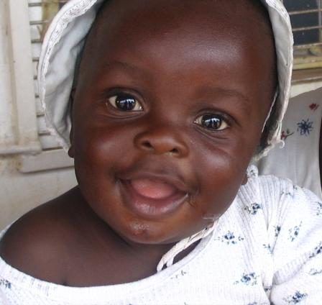
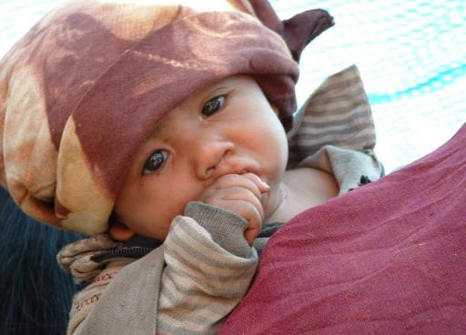
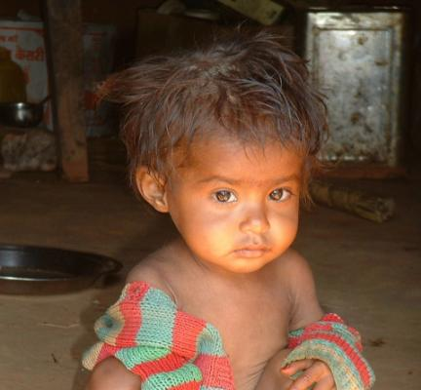
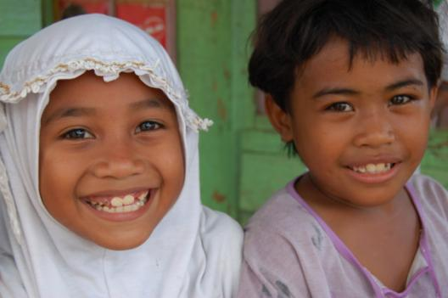
Thanks – Questions?

Slide 51
Routine Immunization vs
Supplementary Immunization Activities
 | Routine Immunization | Supplementary Immunization Activities
Objective | Provide all vaccines listed on country RI schedule | Provide specific vaccines to those who missed them in RI or who did not seroconvert
Service Delivery | Ongoing basis from permanent locations | Temporarily provided from multiple permanent and temporary locations
Timing | Throughout the year | Short duration (1 week)
Target | Usually <1 year olds | Usually <5 or <15 year olds
Other names | EPI (Expanded Program on Immunization); UIP (Universal Immunization Program) | campaigns, NIDs (National Immunization days), SNIDs (sub-national immunization days), PIRIs (Periodic Intensification of Routine Immunization)

