Slide 1
Injection Safety
IPV Global Workshop
March 25, 2014

Slide 2
Outline
Background
IPV
Injection Equipment
Waste Disposal

Slide 3
Injection Use Worldwide
95% are for therapeutic purposes
5% are immunization injections
1% are used for injectable contraceptives
1% are of blood and blood products
> WHO estimates 50% of injections in developing countries are unsafe….
www/who/int/mediacentre/factsheets/fs231/en. Oct 2006

Slide 4
Safe injection
No harm
“Immunization injections are only safe when the correct vaccine is properly administered with a sterile injection device that is disposed safely”
WHO recommended policy

Slide 5
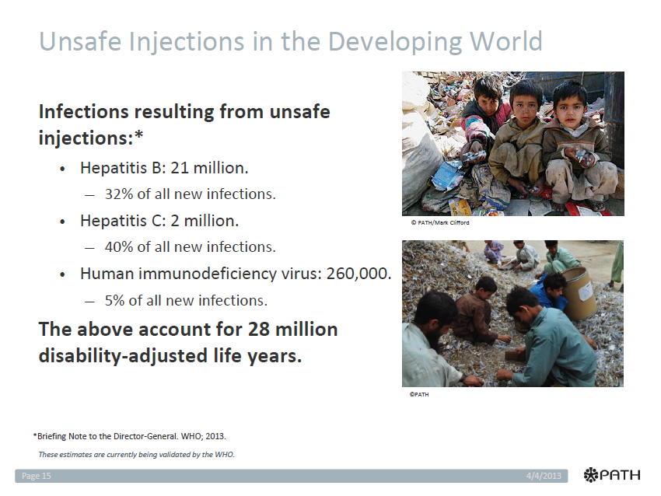

Slide 6
Unsafe practices
Pre-filling syringe with vaccine
Re-capping needle
Re-using needles and/or syringes
Improper waste disposal

Slide 7
Factors that contribute to disease transmission
Overuse of therapeutic injections
Shortage injection equipment
Poor waste disposal practices
Re- use of syringes and needles

Slide 8
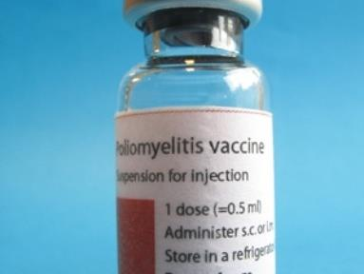
Inactivated Polio Vaccine 1 dose

Slide 9
Administration of IPV
Delivered intramuscular (IM)
Delivered subcutaneous (SC)
Requires syringe and needle
Mono dose
Multi dose

Slide 10
Safe Injection Equipment
All countries should be using only auto-disable syringes or syringes with re-use prevention feature.
Auto-disable syringes and safety boxes should be supplied in adequate quantities for campaigns and routine immunization services

Slide 11
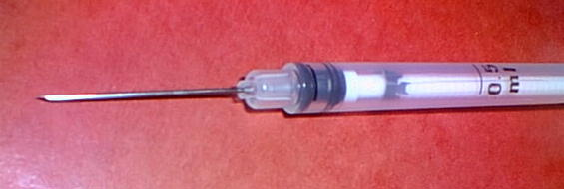
Sterile Injection Device
A-D (auto-disable) needle and syringe--locks plunger after one use
Internal mechanism blocks plunger once it is fully pressed.
Injection stroke
LOCK !

Slide 12
Sterile Injection Devices
GOOD: Disposable needle and syringe
  Without recapping needle
  Without re-using needle and syringe
  BEST: Syringes with re-use or needle stick prevention features
  Re-use by HCW’s or patients
  Needle related injuries and infections

Slide 13
Needle Free Devices
Jet-Injectors
  Used for Smallpox Eradication
  Cross contamination concern
  Human and animal testing for new devices
Aerosol administration
  Measles vaccine—clinical trials in Mexico Influenza vaccine

Slide 14
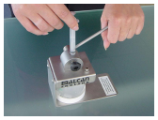
Hub Cutter
Syringe hub cutter
  Destroys needle and syringe to prevent reuse
  Reduces volume of waste

Slide 16
Safe Disposal
“The collection, storage and subsequent destruction of all syringes and needles to avoid any accidents”

Slide 17
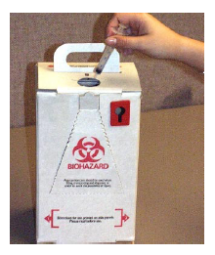
Safety Boxes:
Sharps containers used for the disposal of safe and convenient disposal of syringes, needles and other sharps.

Slide 18
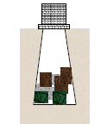
Waste Disposal
Permanent
  Incineration
  Burning
    In a metal drum
    Open pit
  Burial
    Encapsulation

Slide 19
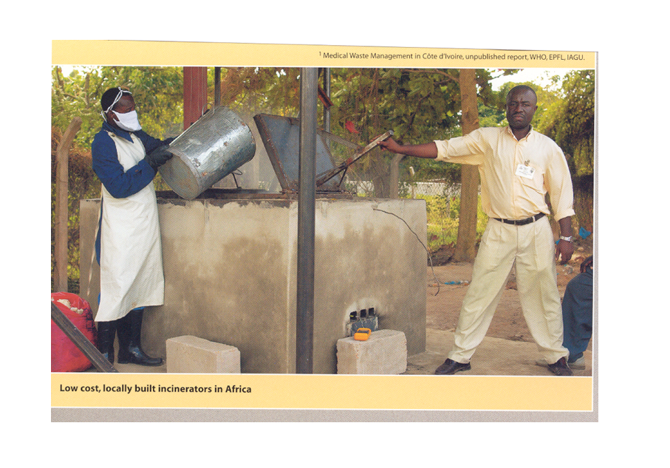
Incinerator

Slide 20
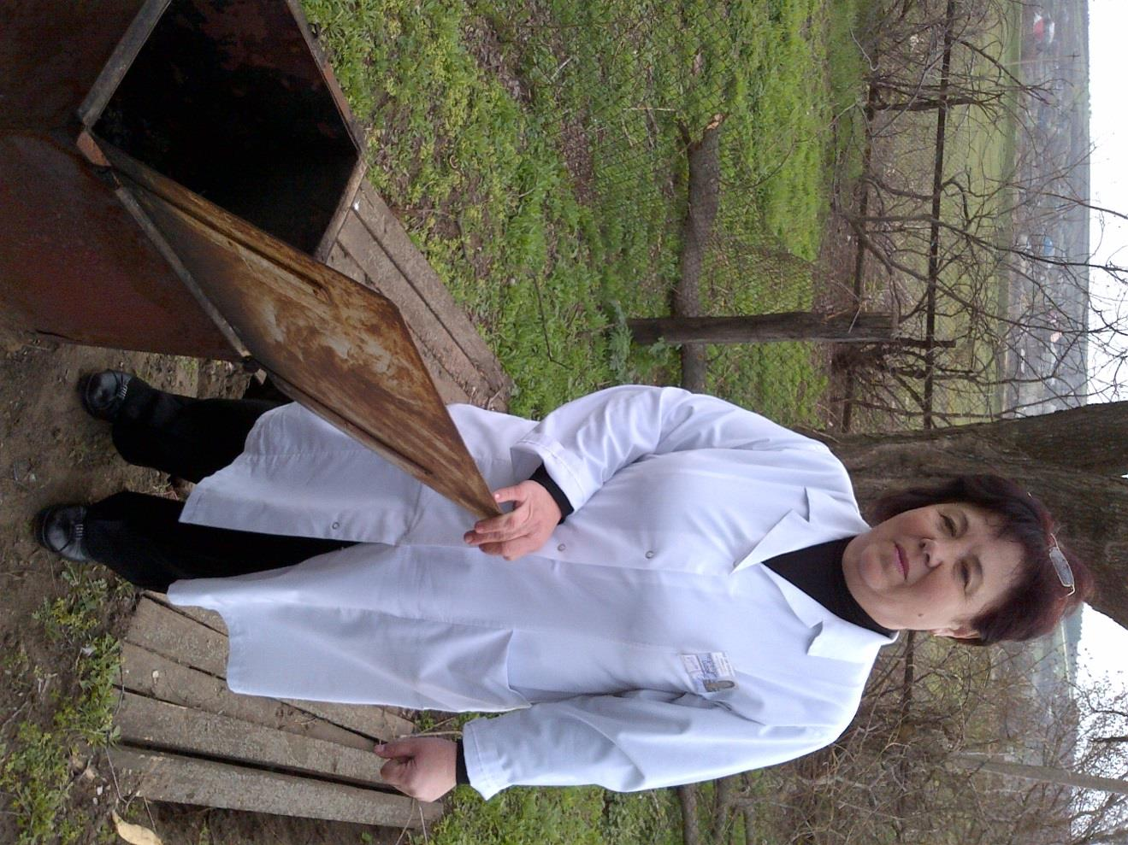
Metal Drum

Slide 21
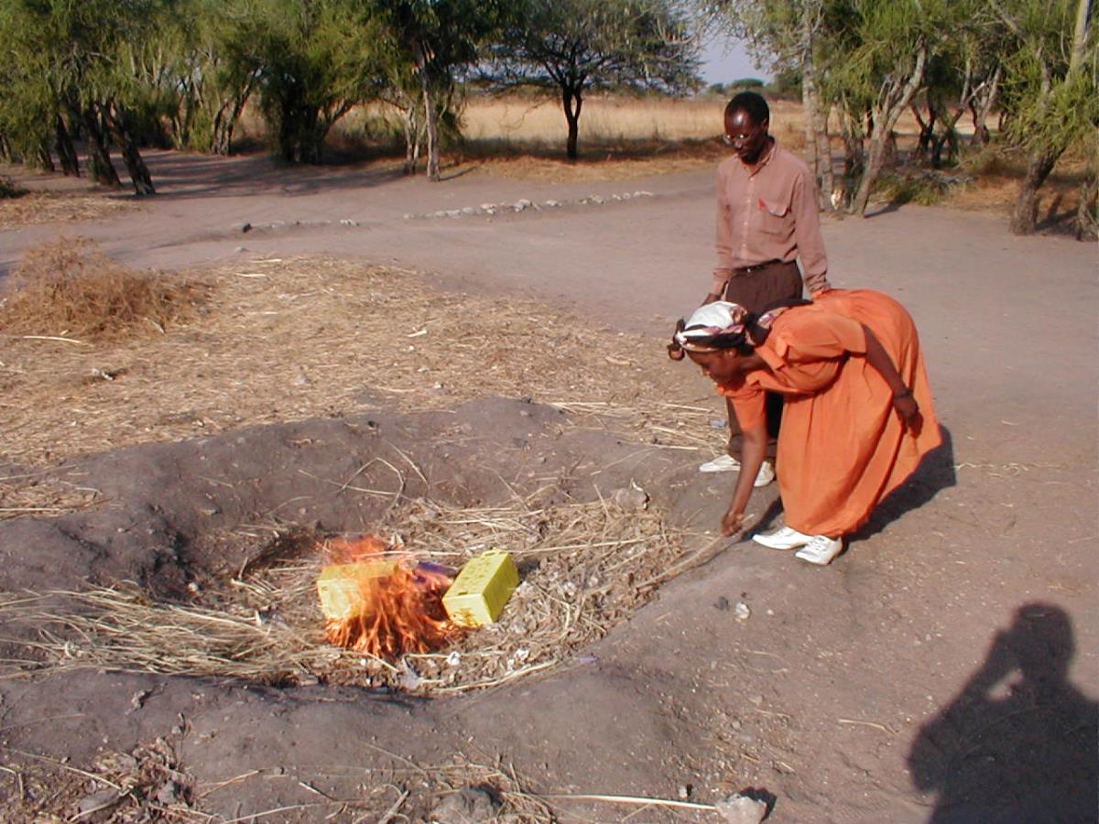
Open Shallow Pit

Slide 22
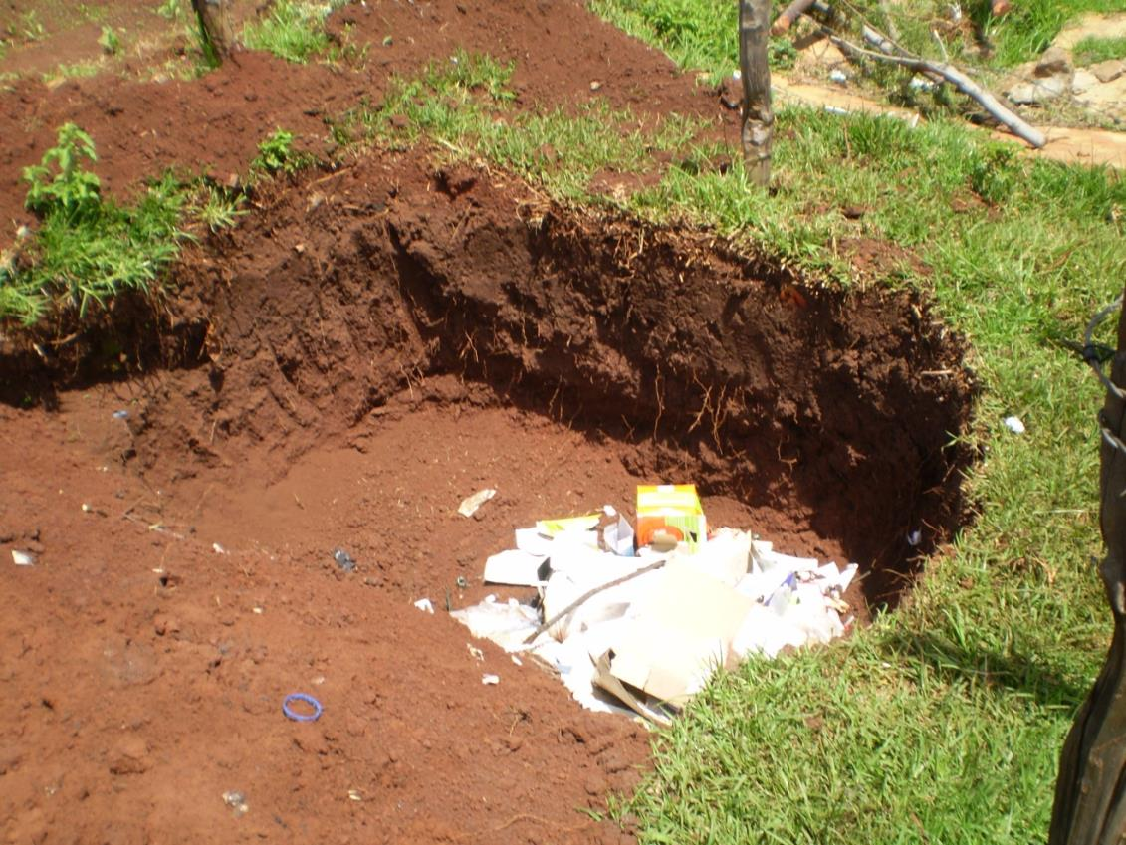
Deep Open Pit

Slide 23
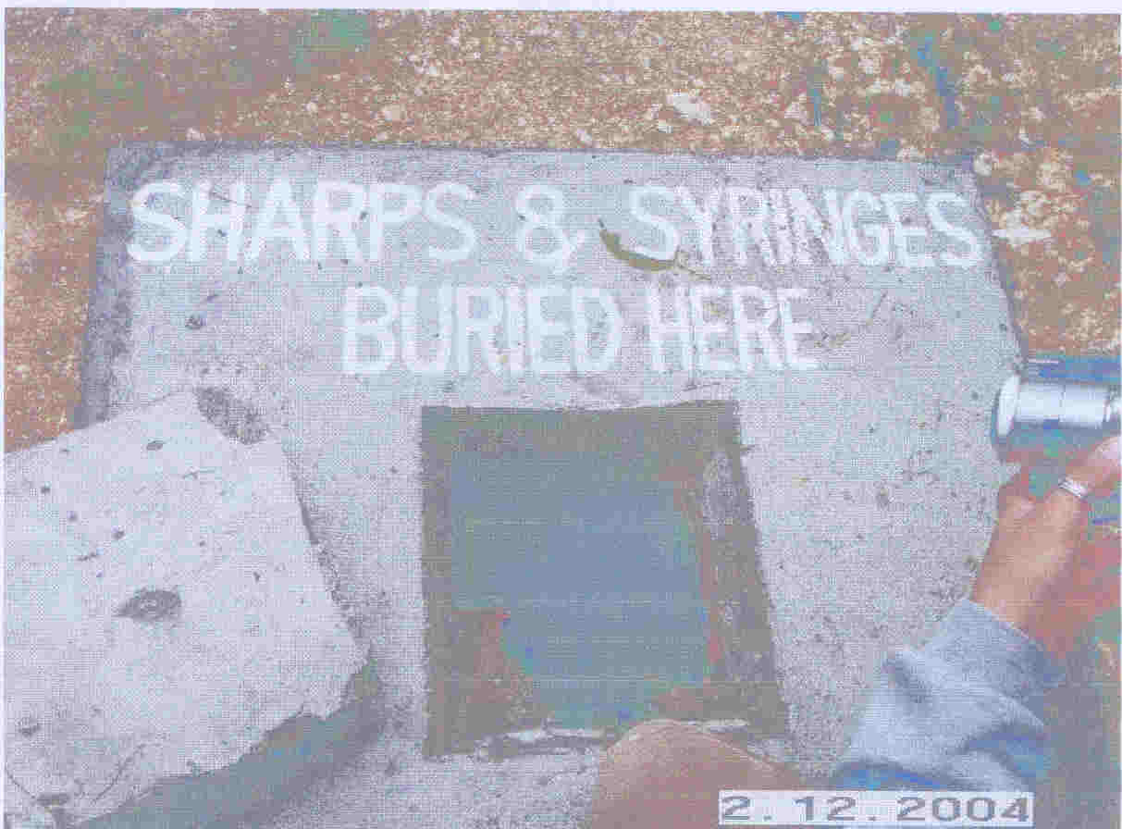
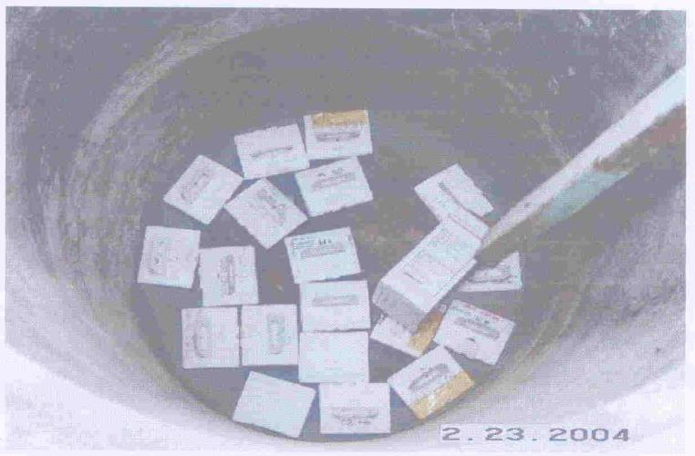
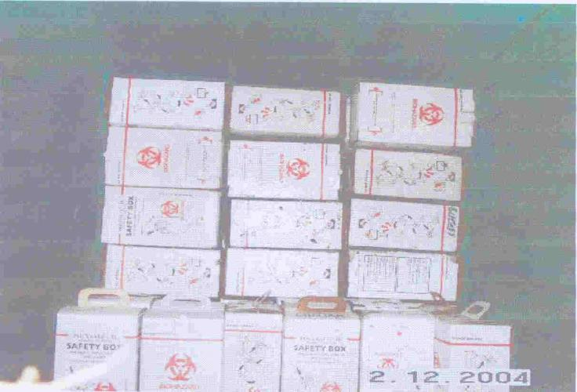
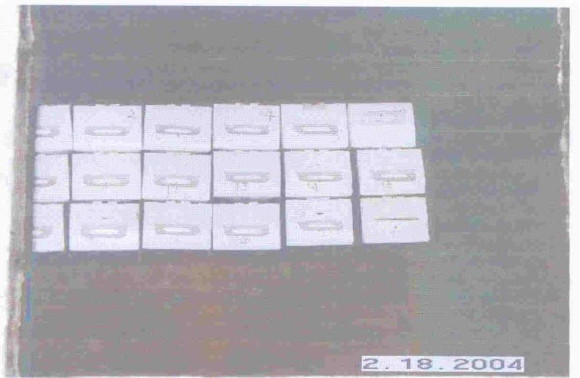
Burial
Waste Disposal

Slide 24

Resources
Guiding principles to ensure injection device security—WHO 2003
  http://www.who.int/injection_safety/WHOGuidPrinciplesInjEquipFinal.pdf
Aide memoire and checklist for injection safety—WHO 2003
  (http://www.who.int/vaccines-documents/DocsPDF04/www775.pdf)
Safe Injection Global Network (SIGN)
  http://www.who.int/injection_safety/sign/en/

