Slide 1
Introduction to Information Systems for Immunization Services
IPV Global Workshop
March 2014

Slide 2
Outline
Importance of data
Common information system elements
What you can do to improve the information system

Slide 3
Why are data important?
High quality data on immunization coverage, VPD surveillance and other programs are necessary for
  informed planning
  program implementation and
  evaluation of public health practice

Slide 4
About the information system

Slide 5
Data Management Cycle
Data Collection/
Record Keeping/
Archiving

Slide 6
Data Management Cycle
Data Collection/
Record Keeping/
Archiving
Feed Back
Data Reporting

Slide 7
Data Management Cycle
Data Collection/
Record Keeping/
Archiving
Feed Back
Data Reporting
Feed Back
Electronic Data Entry
& Management

Slide 8
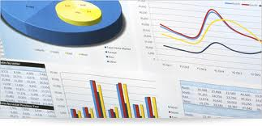
Data Management Cycle
Data Collection/
Record Keeping/
Archiving
Feed Back
Data Reporting
Data Analysis
Feed Back
Feed Back
Electronic Data Entry
& Management

Slide 9
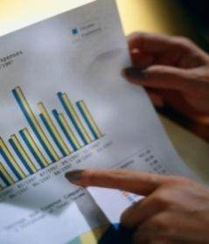
Data Management Cycle
Data Use
Data Collection/
Record Keeping/
Archiving
Feed Back
Data Reporting
Data Analysis
Feed Back
Feed Back
Electronic Data Entry
& Management

Slide 10
Data Management Cycle
Data Use
Data Collection/
Record Keeping/
Archiving
Feed Back
Cross Cutting: Collection of Quality Data
- accurate, reliable, representative
Data Reporting
Data Analysis
Feed Back
Feed Back
Electronic Data Entry
& Management

Slide 11
Recording Information During a Vaccination Visit
The immunization register
  Used to record beneficiary information:
    Beneficiary name, address, phone, parents’ info, DOB
    Dates when vaccines are received
Tally sheets
  Used to record number of doses administered in an immunization session
    No child information, just number of doses given for each vaccine within a single immunization session
  Tally sheet data is consolidated into monthly reporting forms
Vaccination cards
  Used by parents to maintain health records at home
    Record date of each vaccination dose; use as a reminder for when to return

Slide 12
EPI Register Example
Notes:
Ensure registers are by name and not by date of vaccination

Slide 13
Tally Sheet Example

Slide 14
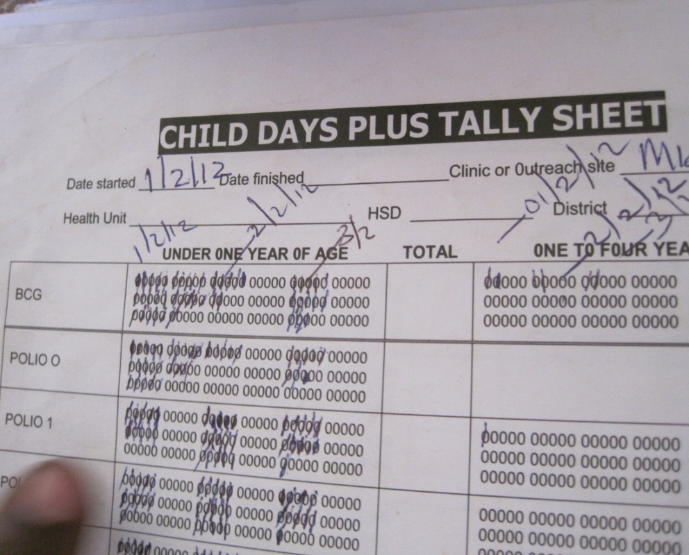
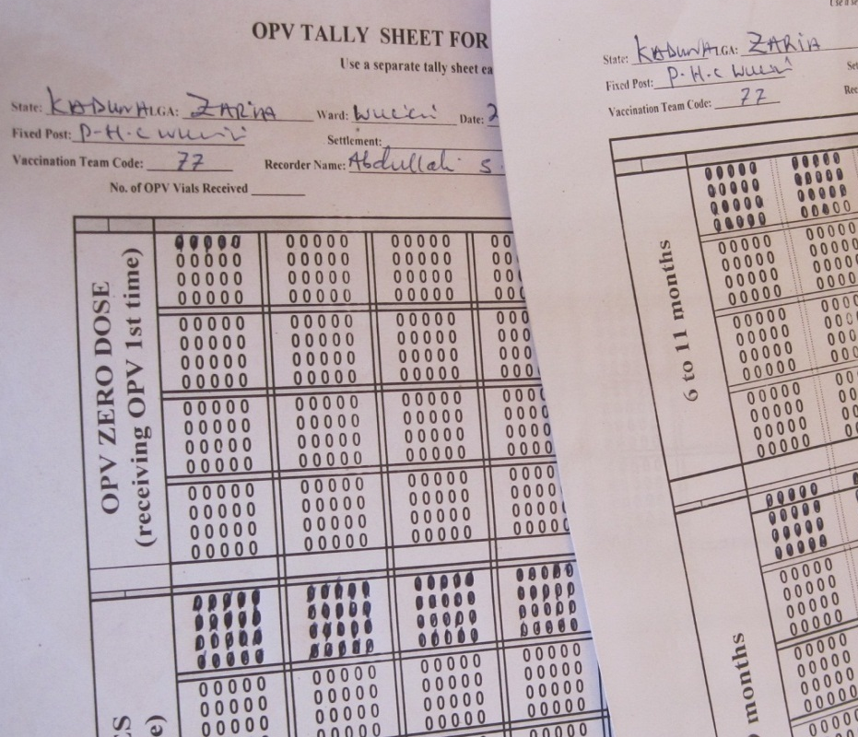
Data recording practice example
Example: Good recording practice
Use of standard form
Handwriting clear
1 tally sheet used per immunization session
Example: Poor recording practice
Use of standard form
Handwriting NOT clear
1 tally sheet ≠ immunization session

Slide 15
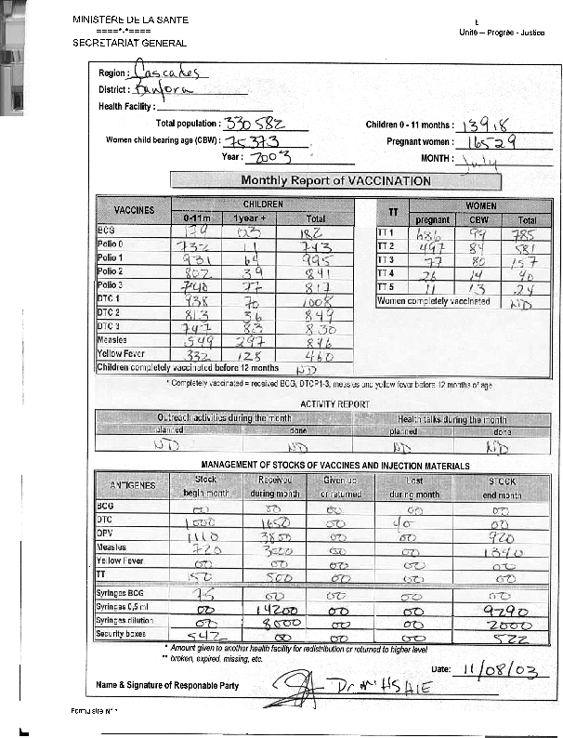
Example of monthly report sent from lower levels upwards
Monthly doses administered per vaccine
Monthly vaccine stock used per vaccine
Notes:
Administrative data
# doses of each vaccine administered (BCG, DTP1-3, OPV0-3, measles, TT)
Usually split by child age (< 1 yr; > 1 yr)
Compiled on “tally sheets” at each health facility (example)

Slide 16
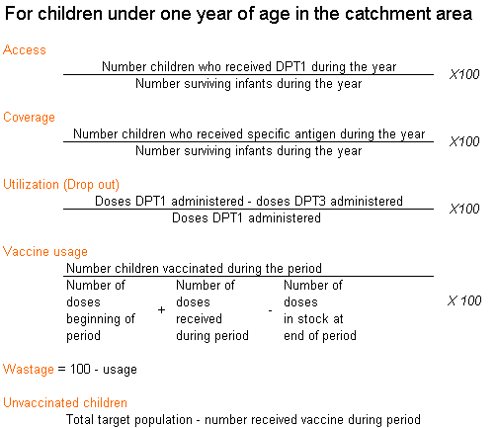
Common system performance indicators (1)
A number of system indicators will commonly be calculated at all administrative levels
Coverage target: 90% national coverage in each antigen and at least 80% in each district
Drop out target: < 10%

Slide 17
Common system performance indicators (2)
Wastage target
  10 – 25%
  Varies by antigen
  Campaign vs. routine
  Should not be emphasized over coverage!

Slide 18
How you can play a role

Slide 19
How does IPV introduction impact the information system?
IPV introduction will require updates of all information reporting forms
  Vaccination cards, immunization registers, tally sheets, vaccine stock management registers, electronic health information management systems
Debate may exist around if/how to record IPV versus OPV within information system tools/records
  Important to emphasize the need to record IPV doses separate from OPV so the program staff can understand performance of IPV introduction, address unique issues with introduction (multiple injections, wastage issues etc)

Slide 20
Before Field Visit
While you are at national program try to learn about
  Data flow
  Guidelines and expected responsibilities of local staff regarding data (AFP, measles, routine immunization etc)

Slide 21
Assessment
Wherever you are working, think about the possible data at hand
  Collection: Who? When? How?
  Reporting: Who? When? How? Where?

Slide 22
Ways to check on data use at districts and health facilities
Are standard charts and maps prepared?
Are data interpreted?
  Are there target populations for each level?
  Do they have targets –
    DTP3 < 80% poor coverage
    DTP1 < 80% poor access
    Dropout > 10% poor retention
Quality of denominators / targets
  How are they determined?
  Are any coverage values > 100%?
Are underperforming districts identified and targeted for support?

Slide 23
Checking data flow performance
Completeness
  % of health facilities included in district results
  % of districts included in national results
Timeliness
  % of reports received as of due date
Harmonization
  Data between administrative levels should be the same
Feedback loop exists from the higher levels back to the health facilities

Slide 24
Use of data: Feedback methods you can propose
Monthly/quarterly bulletins
  Increasingly common
  Include a line listing of districts with information on cases, timeliness, number of vaccinations given
  Use of maps to identify district-wise performance by coverage
Supervision
  Inclusion of feedback on submitted data into supervisory visits each administrative level

Slide 25
Common solutions for areas needing improvement
Completeness
  Identify why districts are not filling out form completely and respond
Timeliness
  Identify why districts are slow to send report and respond
Use of data
  Setup feedback system – bulletin, supervisor feedback form, supervisor training,
  Check for use of monitoring charts, defaulting tracking tools, updates to the microplans
Harmonization
  Data quality assessment; cross-checking between administrative levels

Slide 26
Summary
Electronic data and outputs will be only as good as
  the quality of data collected and
  what goes into the computer
Data are not just a data manager’s business
Data are important to everyone and
You can do a lot to help improve data quality

