Slide 1
Supply, Presentation, Procurement Issues

Slide 2
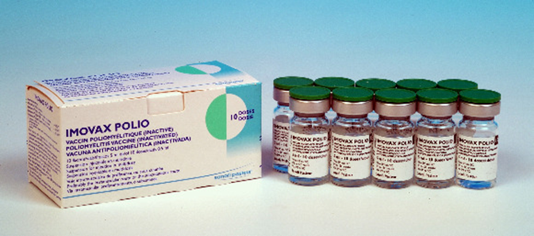
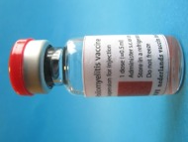
IPV Presentations and Formulations
Stand-alone IPV
Only WHO prequalified formulation
1-dose, [2-dose] and 10-dose available now
5-dose expected in 2014
Preservative: 2-phenoxyethanol does not meet WHO requirements for an effective preservative (multi-dose vial, once opened, must be discarded after 6 hours or at end of immunization session)
Combination products
Combination with whole-cell pertussis not currently available
Tetravalent, pentavalent, hexavalent available
Substantially higher cost than stand-alone IPV

Slide 3
Procurement Objectives
The tender was issued in line with the Procurement Strategy, which was shared with all partners
The strategy outlined three procurement objectives:
To secure sufficient supply to meet an accelerated introduction of IPV for OPV-using countries procuring through UNICEF, for the period of 2014-2017;
To achieve affordable prices from year 1 for all presentations; and
To support the development of a healthy IPV market.

Slide 4
Vaccine Demand Forecast & Supply
GPEI ensured sufficient production capacity for current IPV stand-alone products to meet needs of all OPV using countries to introduce one dose of IPV into routine programmes
Initial global demand forecast: 580-624 million doses needed by 2018
Essential that all countries define target introduction dates no later than mid-end 2014
Four manufacturers currently produce stand-alone IPV
Sanofi- Pasteur, France (SP)
Serum Institute of India (SII)
GlaxoSmithKline, Belgium (GSK)
Statens Serum Institut, Denmark (SSI)

Slide 5
Forecasts 2014-2018: 580m- 624m doses
UNICEF Tender: issued 4 October- closing 15 November
Assumptions: 124 Countries, 1 dose at DTP3; 5 and 10 dose vials (30% and 50% wastage) ; DTP3 coverage reached over one year /two years for large countries

Slide 6
IPV Price US$ – Current & Future
GPEI aims at following pricing levels:
Low-income: ~US$ 1.00 per dose
Lower-middle income: ~US$1.50 per dose
CURRENT Public Sector Price for IPV ranges from ~$2 to $12
Country | Vaccine | Cost per dose
USA¹ | Sanofi (10 dose vial) | $12.42
PAHO² | GSK (1 dose) | $4.14
 | Bilthoven (1 dose) | $2.90
Current UNICEF tender³ | GSK (1 dose) | $4.14
 | Sanofi (10 dose vial) | $2.25 - $2.70
 | SSI (1 dose) | $5.70
http://www.cdc.gov/vaccines/programs/vfc/awardees/vaccine-management/price-list/index.html
http://www.paho.org/hq/index.php?option=com_content&view=article&id=1864&Itemid=2234&lang=en
http://www.unicef.org/supply/index_66260.html

Slide 7
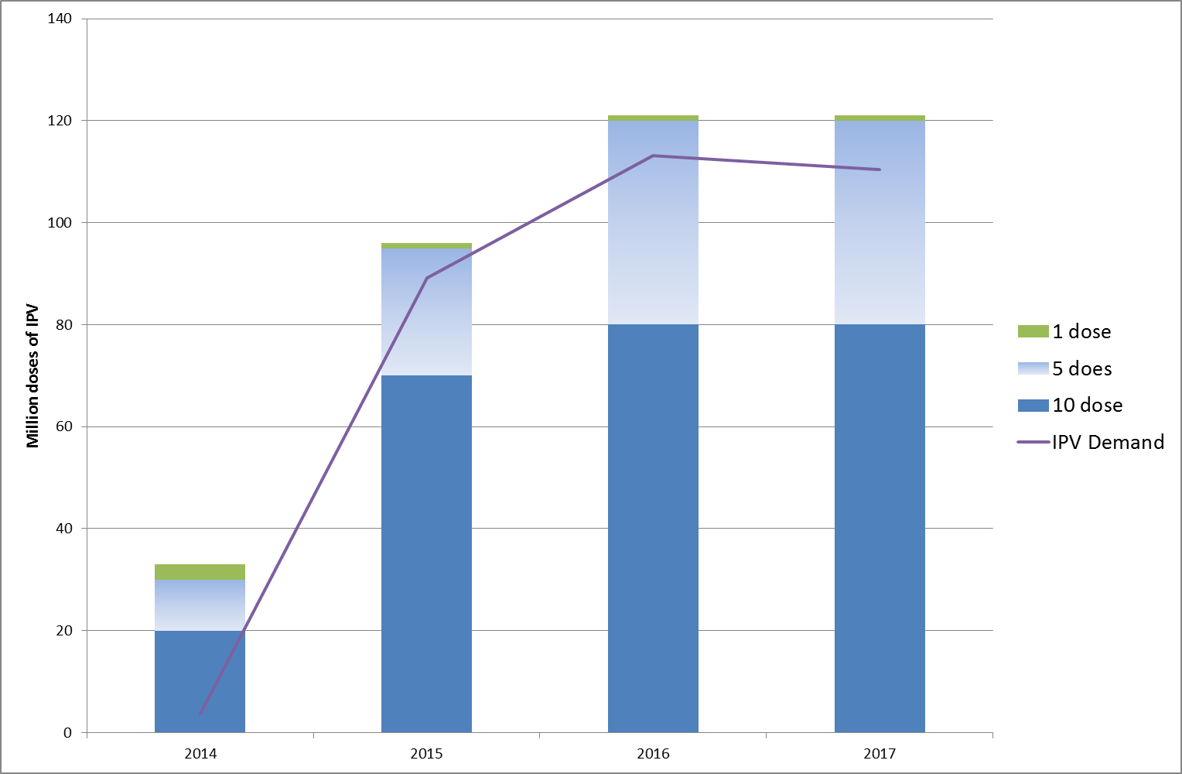
IPV Supply & Demand for Routine Programmes
10 dose availability for 2014 - 5M doses will be available from July, 6M doses from August/September and 9M doses from September and onwards

Slide 8
Number of Manufacturers by Presentation
 | 2014 | 2015 | 2016 | 2017
1 DOSE | 1 | 1 | 1 | 1
5 DOSE* | 1 | 2 | 3 | 3
10 DOSE | 1 | 1 | 1 | 1
* Currently no pre-qualified product
IPV 5 dose presentation
Currently no 5 dose presentation WHO pre-qualified
Expect one manufacturer to have product pre-qualified in Q3 2014 with supply from end Q3 or early Q4
2015 expect a second manufacturer to become pre-qualified
2016 expect to be able to meet all demand for 5 dose presentation
Additional supplier for 1 dose presentation could be available from 2015 if needed
No additional manufacturer is expected for 10 dose presentation over the next 4 years

Slide 9
Lead times for Ordering IPV
This is NOT OPV and not available with manufacturers unless planned
Current lead time: 3 to 6 to 9 months from order placement until vaccine delivered to countries
10 dose presentation: 9 months
1 and 5 dose (when available ): 3 to 6 months
GAVI countries:
GAVI and UNICEF working to reduce lead time for the 10 dose presentation
Confirmed requirements are needed
Non-GAVI countries:
Need to plan introduction based on lead times
Timelines need to be built into countries reordering process for stock management and replenishment of ongoing programmes

Slide 10
Regulatory Issues
Ensuring in-country registration of stand-alone IPV or that WHO prequalification is accepted
At least 75 self-procuring, non GAVI-eligible countries have to licence bOPV and establish post-marketing mechanisms
NRA must be functional (?)

Slide 11
IPV Prices for Supply through UNICEF for period 2014 to 2018
Prices are published on UNICEF website http://www.unicef.org/supply/index_57476.html

Slide 12
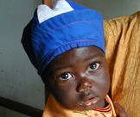
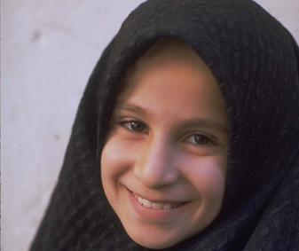
Thank you

